Slide 1

BeiGene-sponsored Satellite Symposium at
ISHL13
26 October 2024, 13:15–14:45 CEST
Cologne, Germany
The evolving role of BTKis in the treatment of
B-cell lymphomas

Slide 2
Disclaimers (1)
The views expressed are those of the speakers and may not necessarily reflect the opinion of BeiGene.
The material may contain information about products or indications that have not yet been approved in your country; for prescriptions, always refer to the product information approved in your country, as well as, where applicable, the reimbursement conditions.
This material is intended for Healthcare Professionals for scientific information exchange purposes only, not for advertising purposes, and does not constitute commercial promotion of any product or recommendation on diagnosis and treatments.

Slide 3
Disclaimers (2)
Zanubrutinib ▼*. Refer to Brukinsa SmPC (MAH: BeiGene Ireland Ltd)
  as monotherapy is indicated in the European Union (EU) for the treatment of adult patients with:
    Waldenström’s macroglobulinaemia (WM) who have received at least one prior therapy, or in first-line treatment for patients unsuitable for chemoimmunotherapy
    Chronic lymphocytic leukaemia (CLL)
    Marginal zone lymphoma (MZL) who have received at least one prior anti-CD20-based therapy
  in combination with obinutuzumab is indicated in the EU for the treatment of adult patients with:
    Refractory or relapsed follicular lymphoma (FL) who have received at least two prior systemic therapies
  Indications may differ outside of the EU. Prescribing information may vary depending on local approval in each country. For the country where you practice medicine, consult the zanubrutinib prescribing and reimbursement information and the local materials, such as the PI and/or the SmPC for guidance on prescribing.
  Zanubrutinib is approved in the US, Australia, China, Brazil, Uruguay, Russia, and the UAE for the treatment of adult patients with mantle cell lymphoma who have received at least one prior therapy. Zanubrutinib is not approved in the EU for patients with mantle cell lymphoma
Sonrotoclax is an experimental orally bioavailable inhibitor of the anti-apoptotic protein B-cell lymphoma 2 (BCL-2), with potential pro-apoptotic and antineoplastic activities. It is currently under Phase 1-3 clinical investigation.
BGB-16673 (BTK degrader) is an experimental oral chimeric degradation activation compound designed to degrade Bruton's tyrosine kinase in the treatment of B-cell malignancies. It is currently under Phase 1 clinical investigations.
* ▼This medicinal product is subject to additional monitoring. This will allow quick identification of new safety information. Healthcare professionals are asked to report any suspected adverse reactions.
CLL, chronic lymphocytic leukemia; EU, European Union; FL, follicular lymphoma; MAH, marketing authorization holder; MZL, marginal zone lymphoma; PI, prescribing information;
SmPC, summary of product characteristics; WM, Waldenström’s macroglobulinaemia.

Slide 4
Disclaimers (3)
Acalabrutinib ▼*. Refer to Calquence SmPC (MAH: AstraZeneca AB).
Axicabtagene. Refer to Yescarta SmPC (MAH: Kite Pharma EU B.V.)
Bendamustine hydrochloride. Refer to Bendamustine hydrochloride (MAH: Zentiva Pharma UK Limited)
Brexucabtagene autoleucel ▼*. Refer to Tecartus SmPC (MAH: Kite Pharma EU B.V.)
Epcoritamab ▼*. Refer to Tepkinly SmPC (MAH: AbbVie Deutschland GmbH & Co. KG)
Ibrutinib. Refer to Imbruvica SmPC (MAH: Janssen-Cilag International NV).
Lisocabtagene maraleucel ▼*. Refer to Breyanzi (MAH: Bristol-Myers Squibb Pharma EEIG)
Obinutuzumab. Refer to Gazyvaro SmPC (MAH: Roche Registration GmbH)
Pirtobrutinib ▼*. Refer to Jaypirca SmPC (MAH: Eli Lilly Nederland B.V)
Rituximab. Refer to MabThera SmPC (MAH: Roche Registration GmbH)
Temsirolimus. Refer to Torisel SmPc (MAH: Pfizer Europe MA EEIG)
Tisagenlecleucel ▼*. Refer to Kymriah SmPC. (MAH: Novartis Europharm Limited)
Venetoclax. Refer to Venclyxto SmPC (MAH: AbbVie Deutschland GmbH Co. KG)
* ▼This medicinal product is subject to additional monitoring. This will allow quick identification of new safety information. Healthcare professionals are asked to report any suspected adverse reactions.
MAH, marketing authorization holder; SmPC, summary of product characteristics.

Slide 5
Learning Objectives
  After this session, participants should have:
  increased knowledge, awareness, and understanding of the contribution of BTKis to improve outcomes in patients with WM, FL, MZL and MCL
  increased awareness of potential future therapeutic options across B-cell malignancies
BTKi, Bruton’s tyrosine kinase inhibitor.

Slide 6

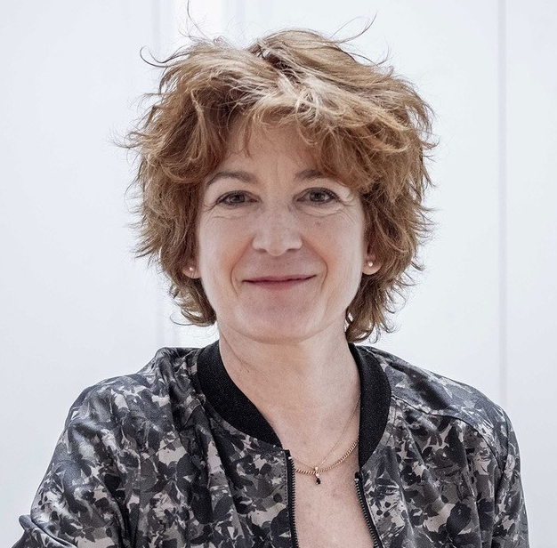


Chair and Speakers
Prof. Christian Buske
Comprehensive Cancer Center, Ulm, Germany
Prof. Catherine Thieblemont
Hôpital Saint-Louis,
Paris, France
Dr. David Lewis
University Hospitals NHS Trust,
Plymouth, UK
Dr. Anna Maria Frustaci
Ospedale Niguarda,
Milan, Italy

Slide 7

The evolving role of BTKis in the treatment of B-cell lymphomas
Agenda
Chair & Speakers
Welcome and introduction
13.15
Christian Buske (Chair)
BTKi in indolent lymphomas (FL, MZL)
13.20
Catherine Thieblemont
BTKi in WM
13:38
Christian Buske
BTKi in MCL
13.56
David Lewis
Future developments (CDAC, BCL2i)
14.14
Anna Maria Frustaci
Panel discussion, audience Q&A
14.32
All
Closure and farewell
14.44
Christian Buske
7

Slide 8

SCAN QR CODE NOW!
Allows you to:
Ask your questions to the faculty.
Provide your feedback and help BeiGene to better meet your educational needs in the future.

Slide 9
BTKi in indolent lymphomas (FL, MZL)
Catherine Thieblemont, MD
Hôpital Saint-Louis,
Paris, France
1024-BGB-3111-MRC-017
Approved: 17 October 2024

Slide 10
Disclosures
COI | Sponsor
Research funding | Roche, Gilead, Janssen
Advisory boards | Novartis, BMS/Celgene, Bayer, AbbVie, Gilead, Roche, Janssen, Kite, Incyte, Amgen, Takeda
Educational activities | Janssen, Roche, BeiGene
COI, conflict of interest.

Slide 11
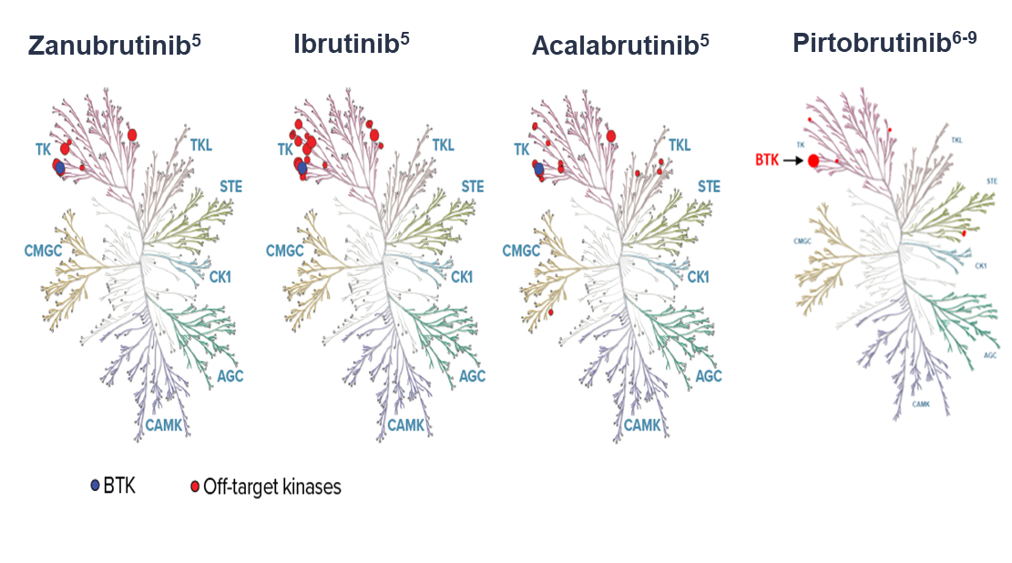
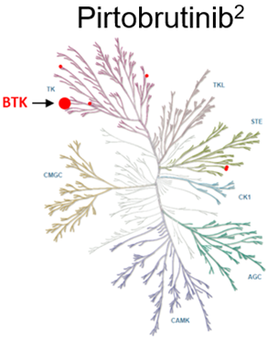
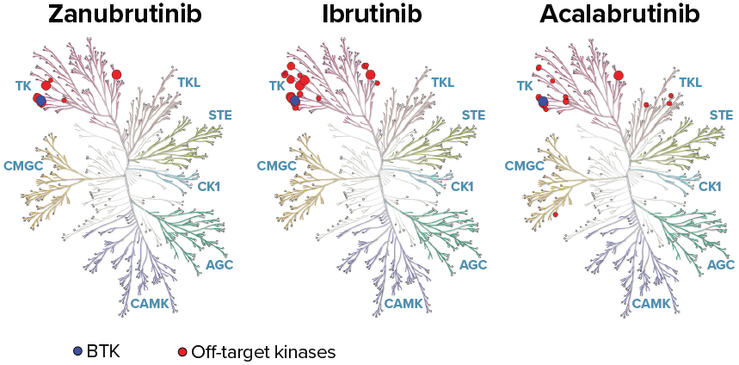
BTK inhibitors
BTKi | Mechanism | Target
Covalent
First Generation
Ibrutinib¹ | Irreversible Binding to Cysteine-481
Second Generation
Acalabrutinib² | Irreversible Binding to Cysteine-481
Next Generation
Zanubrutinib³ | Irreversible Binding to Cysteine-481
Non-Covalent
Pirtobrutinib⁴ | Reversible Binding to ATP-pocket
Ibrutinib⁵
Acalabrutinib⁵
Zanubrutinib⁵
Pirtobrutinib⁶⁻⁹
Assayed by Reaction Biology Corp. at 100X of IC50 (against BTK) concentration with IC50 (BTK)s of 0.71±0.09, 0.32±0.09, and 24±9.2, for zanubrutinib, ibrutinib, and acalabrutinib, respectively.
Please note, the use of different assays used for the Shadman analyses on zanubrutinib, ibrutinib, and acalabrutinib vs the Mato analysis for pirtobrutinib may result in different selectivity outcomes.
BTK, Bruton tyrosine kinase; IC₅₀, half-maximal inhibitory concentration.
1) Imbruvica SmPC. Available at: https://www.ema.europa.eu/en/medicines/human/EPAR/imbruvica; 2) Calquence SmPC. Available at: https://www.ema.europa.eu/en/medicines/human/EPAR/calquence;
3) Brukinsa SmPC. Available at: https://www.ema.europa.eu/en/medicines/human/EPAR/brukinsa; 4) Jaypirca SmPC. Available at: https://www.ema.europa.eu/en/medicines/human/EPAR/jaypirca.
Adapted from 5) Shadman M et al. Lancet Haematol. 2023;10(1):e35-e45; 6) Mato AR et al. Lancet. 2021;397(10277):892-901; 7) Munir T et al. Presented at the BSH; 3-5 April 2022; Manchester, UK (Poster PO55). Available at: https://www.postersessiononline.eu/173580348_eu/congresos/BSH2022/aula/-PO_55_BSH2022.pdf; 8) Brandhuber BJGE and Smith S. Clin Lymphoma Myeloma Leuk. 2018;18:S216;
9) Gomez EB at al. Blood. 2023;142(1):62–72.

Slide 12
BTKi regulatory approvals
Indolent lymphomas
 | CLL |  | WM |  | MZL |  | FL |  | MCL
 | EU | US | EU | US | EU | US | EU | US | EU | US
Zanubrutinib¹ | ✔️ | ✔️ | ✔️ | ✔️ | ✔️ | ✔️ | ✔️ | ✔️ | planned | ✔️
Ibrutinib² | ✔️ | ✔️ | ✔️ | ✔️ |  | withdrawn⁵ |  |  | ✔️ | withdrawn⁵
Acalabrutinib³ | ✔️ | ✔️ |  |  |  |  |  |  |  | ✔️
Pirtobrutinib⁴ |  | ✔️
BTKi, Bruton’s tyrosine kinase inhibitor; CLL, chronic lymphocytic leukemia; EU, European Union; FL, follicular lymphoma; MCL, mantle cell lymphoma; MZL, marginal zone lymphoma; US, United States (of America); WM, Waldenström’s macroglobulinemia.
1) Brukinsa SmPC. Available at: https://www.ema.europa.eu/en/medicines/human/EPAR/brukinsa; 2) Imbruvica SmPC. Available at: https://www.ema.europa.eu/en/medicines/human/EPAR/imbruvica;
3) Calquence SmPC. Available at: https://www.ema.europa.eu/en/medicines/human/EPAR/calquence; 4) Jaypirca SmPC. Available at: https://www.ema.europa.eu/en/medicines/human/EPAR/jaypirca;
5) J&J Press release, 06 April 2023. Available at: https://www.jnj.com/media-center/press-releases/update-on-imbruvica-ibrutinib-u-s-accelerated-approvals-for-mantle-cell-lymphoma-and-marginal-zone-lymphoma-indications.

Slide 13
Follicular lymphoma

Slide 14
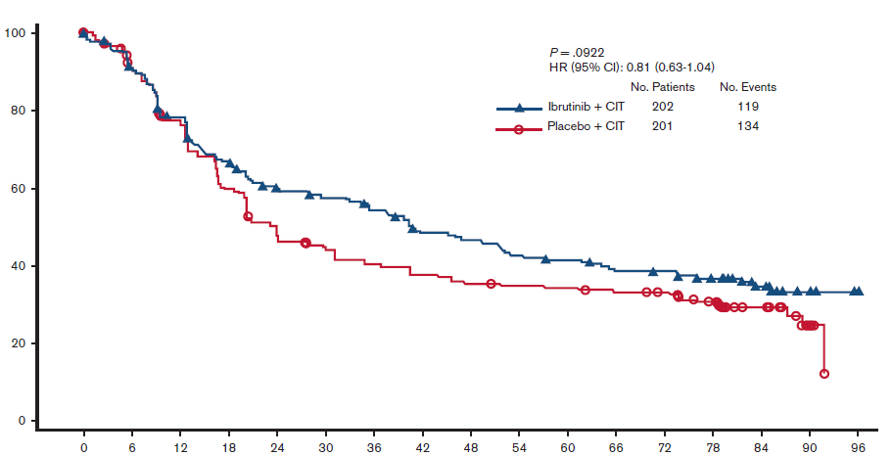
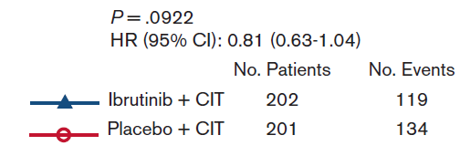
Ibrutinib for R/R FL or MZL
SELENE: Phase 3 study of Ibru + CIT vs CIT
Ibrutinib monotherapy:
Phase 2 DAWN trial²: ORR 20.9%, CR 11%
Phase 2 consortium³: ORR 37.5%, CR 12.5%
Investigator-assessed PFS¹
Summary¹
Most patients (86.1%) had FL
CIT was BR (90.3%) or R-CHOP
The addition of Ibru to CIT did not significantly improve PFS compared with placebo + CIT
The safety profile was consistent with known profiles of ibrutinib and CIT
Progression-free survival (%)
Time (months)
This slide includes data from different clinical trials. These data are meant for demonstration purposes only and are not meant for cross-trial comparison purposes.
BR, bendamustine and rituximab; CIT, chemoimmunotherapy; FL, follicular lymphoma; HR, hazard ratio; Ibru, ibrutinib; MZL, marginal zone lymphoma; PFS, progression-free survival; R-CHOP, rituximab, cyclophosphamide, doxorubicin, vincristine, and prednisone; R/R, relapsed/refractory.
Adapted from 1) Nastoupil LJ et al. Blood Adv. 2023;7(22):7141–7150; 2) Gopal AK et al. J Clin Oncol. 2018;36(23):2405-2412; 3) Bartlett NL et al. Blood. 2018;131(2):182-190.

Slide 15
ROSEWOOD Study design¹
Zanubrutinib Plus Obinutuzumab Versus Obinutuzumab in Patients With R/R Follicular Lymphoma: Updated Analysis of the ROSEWOOD Phase 2 Study
Arm A
Zanubrutinibª + obinutuzumab^{b} (N=145)
Until PD or unacceptable toxicity
Key eligibility criteria
Age ≥18 years
Grade 1-3A R/R FL
Previous treatment with ≥2 lines of therapy, including an anti-CD20 antibody and an alkylating agent
Measurable disease
ECOG PS of 0-2
Adequate organ function
No prior BTK inhibitor
Primary endpoint
ORR by IRC according to Lugano 2014 classification¹
Other endpoints
DOR by IRC^{c}
PFS by IRC^{c}
OS^{c}
TTNT
Safety (AEs)^{c}
Randomization 2:1
Stratification factors
Number of prior lines of treatment
Rituximab-refractory status
Geographic region
²
Arm B
Obinutuzumab^{b} (N=72)
Option to cross over to combination if PD is centrally confirmed or if there is no response at 12 months
127 sites; 17 countries/regions
Randomized November 2017 to June 2021
ªZanubrutinib was given orally at 160 mg twice daily; ^{b}Obinutuzumab was given intravenously at 1000 mg in both arms on days 1, 8, and 15 of cycle 1, day 1 of cycles 2-6, and then every 8 weeks up to a maximum of 20 doses; ^{c}Secondary endpoint.
AE, adverse event; BTK, Bruton tyrosine kinase; DOR, duration of response; ECOG PS, Eastern Cooperative Oncology Group performance status; FL, follicular lymphoma; IRC, independent review committee; ORR, objective response rate; OS, overall survival; PD, progressive disease; PFS, progression-free survival; R/R, relapsed or refractory; TTNT, time to next treatment.
1) Adapted from Zinzani PL et al. Zanubrutinib Plus Obinutuzumab Versus Obinutuzumab in Patients With Relapsed/Refractory Follicular Lymphoma: Updated Analysis of the ROSEWOOD Study. Presented at the 17th International Conference on Malignant Lymphoma; June 13-17, 2023; Lugano, Switzerland; Abstract 81 (Accessed 04 June 2024). Available at: Zinzani_BGB-3111-212_ICML_Presentation_2023.pdf; 2) Cheson BD et al, J Clin Oncol. 2014;32(27):3059-3067.

Slide 16
ROSEWOOD: Study population was heavily pretreated and had refractory disease
Characteristics | Zanu + Obi (n=145) | Obi (n=72)
Age, median (range), years | 63.0 (31-84) | 65.5 (32-88)
ECOG PS of ≥1, n (%) | 59 (40.6) | 41 (57.0)
FLIPI score of ≥3, n (%) | 77 (53.1) | 37 (51.4)
Ann Arbor stage III-IV, n (%) | 119 (82.1) | 60 (83.3)
Bulky disease (≥7 cm), n (%) | 23 (15.9) | 12 (16.7)
High LDH level (>ULN), n (%) | 49 (33.8) | 29 (40.3)
High tumor burden per GELF criteria, n (%) | 83 (57.2) | 40 (55.6)
No. of prior lines of therapy, median (range) | 3 (2-11) | 3 (2-9)
Refractory to rituximab, n (%) | 78 (53.8) | 36 (50.0)
Refractory to most recent line of therapy, n (%) | 47 (32.4) | 29 (40.3)
PD ≤24 months after starting first line of therapy, n (%) | 50 (34.5) | 30 (41.7)
Prior therapy, n (%)
Chemoimmunotherapy | 143 (98.6) | 71 (98.6)
Anthracyclines | 118 (81.4) | 57 (79.2)
Cyclophosphamide | 136 (93.8) | 68 (94.4)
Bendamustine | 79 (54.5) | 40 (55.6)
ECOG PS, Eastern Cooperative Oncology Group performance status; FLIPI, Follicular Lymphoma International Prognostic Index; GELF, Groupe d’Etude des Lymphomes Folliculaires; LDH, lactate dehydrogenase; Obi, obinutuzumab; PD, progressive disease; ULN, upper limit of normal; Zanu, zanubrutinib.
Adapted from Zinzani PL et al. J Clin Oncol. 2023;41(33):5107-5117.

Slide 17
ROSEWOOD: ORR difference by IRC was 22.7% in favor of Zanu-Obi at median study follow-up of 20.2 months
Endpoint | Zanu + Obi (n=145) | Obi (n=72) | 2-sided P value
ORR by IRCª (95% CI), % | 69.0 (60.8-76.4) | 45.8 (34.0-58.0) | .0012
CR | 39.3 | 19.4 | .0035
PR | 29.7 | 26.4 | –
DOR by IRC
Median (95% CI), months | NE (25.3-NE) | 14.0 (9.2-25.1) | –
18-month DOR rate (95% CI), % | 69.3 (57.8-78.2) | 41.9 (22.6-60.1) | –
DOCR by IRC
Median (95% CI), months | NE (26.5-NE) | 26.5 (2.7-NE) | –
18-month DOCR rate (95% CI), % | 87.4 (73.8-94.2) | 51.1 (21.0-74.9) | –
ªORR difference by IRC was 22.7%; 95% CI, 9.0%–36.5%.
CR, complete response; DOCR, duration of CR; DOR, duration of response; IRC, independent review committee; NE, not estimable; Obi, obinutuzumab; ORR, objective response rate; PR, partial response;
Zanu, zanubrutinib.
Adapted from Zinzani PL et al. J Clin Oncol. 2023;41(33):5107-5117.

Slide 18
ROSEWOOD: DOR and PFS were longer with Zanu-Obi
DOR by IRC
PFS by IRC
100
100
Zanubrutinib + obinutuzumab
mDOR, NE (25.3 mo-NE)
80
80
Zanubrutinib + obinutuzumab
mPFS, 28.0 (16.1-NE) mo
60
60
DOR, %
PFS, %
40
40
Obinutuzumab
HR, 0.50; 95% CI, 0.33-0.75
Obinutuzumab
P=.0007ª
20
mDOR, 14.0 (9.2-25.1) mo
20
mPFS, 10.4 (6.5-13.8) mo
Censored
Censored
0
0
0
4
8
12
16
20
24
28
32
36
40
0
4
8
12
16
20
24
28
32
36
40
44
Months
Months
Zanubrutinib + obinutuzumab
No. at risk
No. at risk
100
97
82
73
68
59
51
43
40
33
23
21
19
12
10
7
3
3
2
1
1
0
145
135
116
96
92
79
67
62
56
45
38
35
25
22
15
10
9
5
3
3
1
1
0
Obinutuzumab
33
29
24
23
20
16
13
11
10
9
8
6
5
3
2
2
2
0
72
63
42
34
30
27
19
16
15
12
11
9
8
8
5
3
3
2
1
1
0
ªDescriptive 2-sided P value.
DOR, duration of response; HR, hazard ratio; IRC, independent review committee; mDOR, median DOR; mPFS, median progression-free survival; NE, not estimable; Obi, obinutuzumab; zanu, zanubrutinib.
Adapted from Zinzani PL et al. J Clin Oncol. 2023;41(33):5107-5117.

Slide 19
ROSEWOOD: There were no unexpected safety findings with Zanu-Obi
Common nonhematologic TEAEs (any grade)
Grade ≥3 non-hematologic TEAEs
n (%) | Zanu + Obi (n=143) | Obinutuzumab (n=71)
Pneumonia | 14 (9.8) | 3 (4.2)
COVID-19 | 8 (5.6) | 2 (2.8)
COVID-19 pneumonia | 5 (3.5) | 2 (2.8)
Diarrhea | 4 (2.8) | 1 (1.4)
Febrile neutropenia | 3 (2.1) | 1 (1.4)
Atrial fibrillation | 2 (1.4) | 0
IRR | 1 (0.7) | 3 (4.2)
Hypertension | 1 (0.7) | 1 (1.4)
Pyrexia and IRR occurred more frequently with obinutuzumab alone
Patients, %
IRR, injection-related reaction; Obi, obinutuzumab; TEAE, treatment-emergent adverse event; Zanu, zanubrutinib.
Adapted from Zinzani PL et al. J Clin Oncol. 2023;41(33):5107-5117.

Slide 20
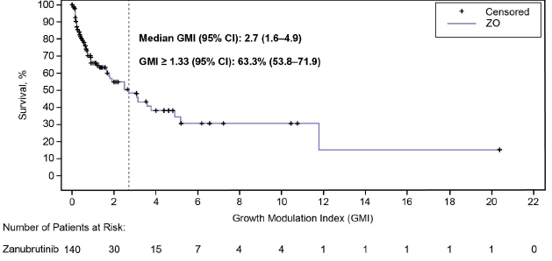
Growth Modulation Index (GMI) analysis of Zanu-Obi efficacy in R/R FL
INTRAPATIENT COMPARATIVE ANALYSIS OF ZANUBRUTINIB PLUS OBINUTUZUMAB EFFICACY IN RELAPSED/REFRACTORY FOLLICULAR LYMPHOMA USING THE GROWTH MODULATION INDEX
Post hoc GMI analysis of data from ROSEWOOD showed that most (>60%) of patients with R/R FL receiving Zanu-Obi had a significant (GMI ≥1.33) improvement in PFS vs their last prior treatment, irrespective of the number of prior treatments
In the overall population, the median GMI of 2.7 was more than double the 1.33 threshold for meaningful clinical activity compared with the last prior treatment
  Summary:
These data further support the benefit of Zanu-Obi as a novel treatment option for patients with R/R FL
CI, confidence interval; GMI, growth modulation index; R/R, relapse or refractory; FL, follicular lymphoma; O or Obi, obinutuzumab; Z or Zanu, zanubrutinib.
Bouabdallah K, Liao S, Delarue R, Dima L, Weber D, Dumartin L. EHA 2024; Abstract P1143 (Accessed 04 June 2024). Available at: Bouabdallah_BGB-3111-212_GMI_EHA_Abstract_2024.pdf.

Slide 21
MAHOGANY: Phase 3 study design
MAHOGANY (BGB-3111-308; NCT05100862) is a randomized, open-label, multicenter phase 3 trial of zanubrutinib + anti-CD20 antibody in R/R FL and with R/R MZL
Key eligibility criteria
Age ≥18 years
Histologically confirmed R/R FL (grade 1-3A) or MZL (extranodal, nodal, or splenic)
Previous treatment with ≥1 prior line of systemic therapy, including an anti-CD20–based regimen
In need of treatment according to modified GELF criteria¹
Adequate bone marrow and organ functions
No prior treatment with BTK inhibitor
Prior lenalidomide treatment allowed unless no response or short remission (DOR <24 months)
No clinically significant cardiovascular disease, severe or debilitating pulmonary disease, or history of a severe bleeding disorder
zanubrutinib + obinutuzumab (until PD)
FL cohort
n=600
R
1:1
Primary endpoint
PFS
Secondary endpoints
ORR
OS
TTNT
HR-QoL
Safety
lenalidomide + rituximab
Stratification:
Age
No. of prior therapies
Anti-CD20 refractoriness
zanubrutinib + rituximab
MZL cohort
n=150
R
1:1
lenalidomide + rituximab
Stratification:
Age
No. of prior therapies
BTK, Bruton tyrosine kinase; DOR, duration of response; FL, follicular lymphoma; GELF, Groupe d'Etude des Lymphomes Folliculaires; HR-QoL; health-related quality of life; MZL, marginal zone lymphoma;
ORR, overall response rate; OS, overall survival; PD, progressive disease; PFS, progression-free survival; R/R, relapsed/refractory; TTNT, time to next treatment.
Adapted from Sehn LH et al. MAHOGANY: A Phase 3 Trial of Zanubrutinib Plus Anti-CD20 Antibodies vs Lenalidomide Plus Rituximab in Patients With Relapsed or Refractory Follicular or Marginal Zone Lymphoma. Presented at 17th International Conference on Malignant Lymphoma, June 13-17, 2023; Lugano, Switzerland; Abstract 994 (Accessed 04 June 2024).
Available at: Sehn_BGB-3111-308_ICML_Presentation_2023.pdf.

Slide 22
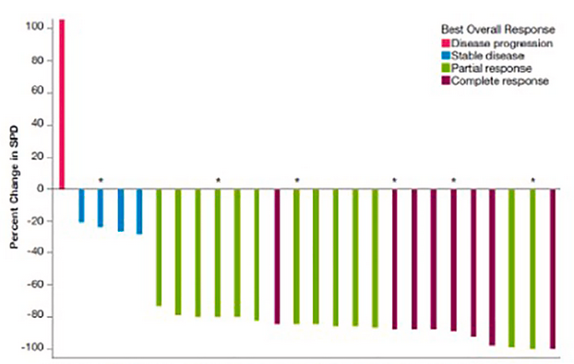
Phase 1 study: acalabrutinib and R² in patients with relapsed FL
Summary of Safety Profile and Efficacy Results
Best % change from baseline in sum of product diameters in Part 3 (A+R² in R/R FL)
100
Best Overall Response
Disease progression
Stable disease
Partial response
Complete response
80
60
40
20
Percent Change in SPD
0
-20
  Summary:
The combination of A + rituximab was well tolerated in TN FL and R/R FL
The addition of lenalidomide 20 mg suggests improved ORR in R/R FL compared with A alone
Further studies of this regimen in FL are needed
-40
-60
-80
-100
* Indicates patient who received lenalidomide 15 mg. All other patients received lenalidomide 20 mg.
A, acalabrutinib; AE, adverse event; CI, confidence interval; CR, complete response; K-M, Kaplan-Meier; ORR, overall response rate; PD, progressive disease; PR, partial response; R², lenalidomide and rituximab; R/R, relapsed/refractory; SD, stable disease; SPD, sum of product diameters; TEAE, treatment-emergent AE; TN, treatment naïve.
Adapted from Strati P et al, Blood. 2022;140(Supplement 1):3606–3608.

Slide 23
Marginal zone lymphoma

Slide 24
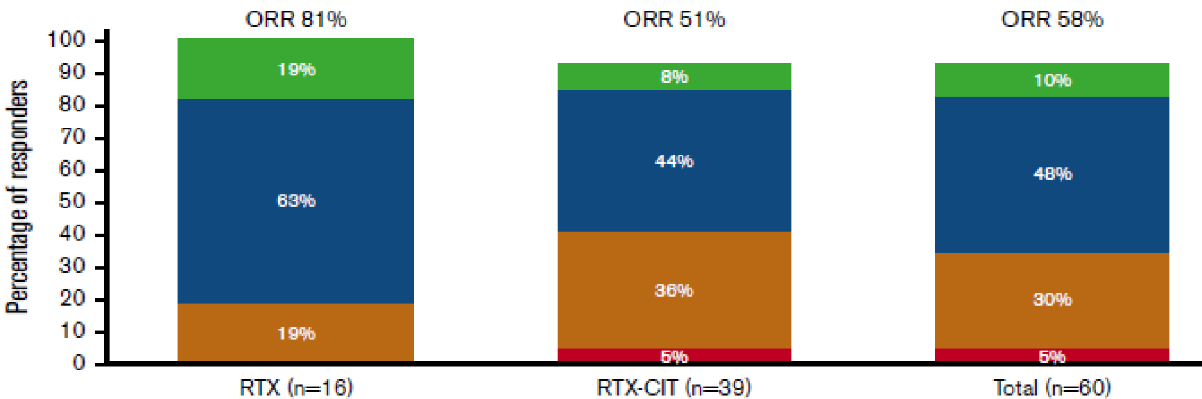
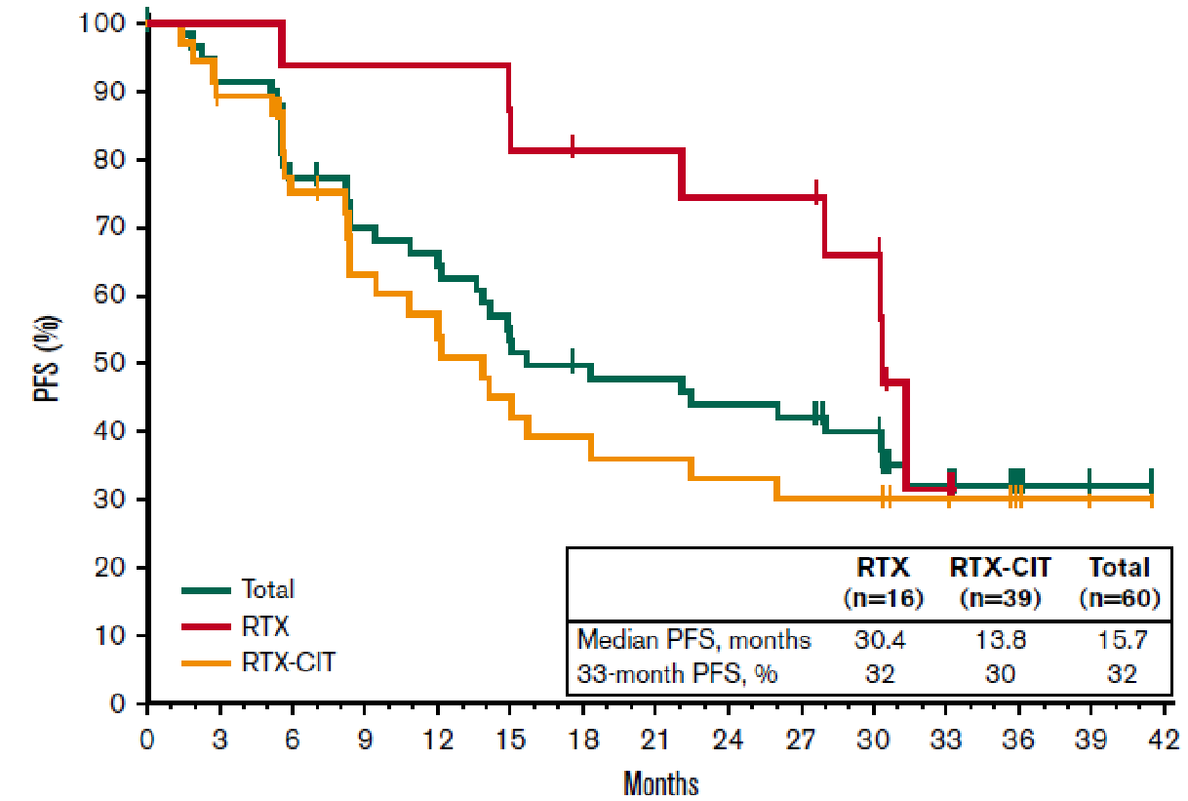
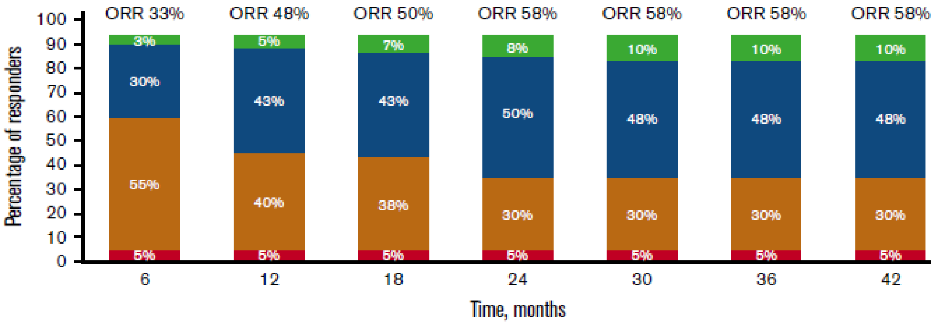

Ibrutinib in R/R MZL, final analysis of Phase 2 study
33.1 months of follow-up: ORR 58% (INV-assessed)
mDOR 27.6 mo
mPFS 15.7 mo, mOS NR (72% at 33 mo)
DOR, PFS, and OS rates at 33 mo were generally similar across MZL subtypes
mPFS better if only prior R (30.4 mo) vs prior R-CIT (13.8 mo)
TNFAIP3 (A20) and MYD88 better response
KMT2D and CARD11 mut had shorter DOR
Prior
Prior
PFS
CIT, chemoimmunotherapy; CR, complete response; INV, investigator; mDOR, medial duration of response; mo, months; mOS, median survival; NR, not reached; PD, progressive disease; PFS, progression-free survival; PR, partial response; SD, stable disease; RTX, rituximab.
Adapted from Noy A et al. Blood Adv. 2020;4(22):5773-5784. This trial was registered at www.clinicaltrials.gov as #NCT01980628.
24

Slide 25
Phase 1b/2 trial: Acalabrutinib monotherapy for R/R MZL
MZL cohort (NCT02180711)
43 patients with R/R MZL
(≥1 prior therapy including ≥1 anti-CD20)
  Extranodal 44%
  Nodal 30%
  Splenic 26%
Primary endpoint: ORR
  Median follow-up: 13.3 months
18 patients discontinued acalabrutinib, mainly due to disease progression
40 patients evaluable for response: ORR 53%
(CR: 13%, PR: 40%)
Median PFS: 27.4 months; 12-month PFS: 67%; median OS: NR
Safety: consistent with prior profile
  Grade ≥3 TEAEs: 17/43 (40%)
  AESI: hypertension: 2/43 (4.7%)
AE, adverse event; AESI, adverse event of interest; CR, complete response; MZL, marginal zone lymphoma; NR, not reached; ORR, overall response rate; OS overall survival; PFS, progression-free survival;
PR, partial response; R/R, relapsed/refractory.
Adapted from Strati P et al. Br J Haematol. 2022;199(1):76-85.

Slide 26
MAGNOLIA (BGB-3111-214)¹: Phase 2, Multicenter, Open-Label, Single-Arm Study
Zanubrutinib monotherapy
(160 mg BID)
Primary Endpoint:
ORR by IRC using Lugano¹
Key Secondary Endpoints:
ORR by PI, PFS, OS,
DOR, safety
R/R MZL
(N=68)
²
68 patients with R/R MZL who received ≥1 CD20-directed regimen
Median age 70 (37-95), ECOG PS 0/1 93%, median prior therapy lines 2 (1-6)
MZL subtypes: extranodal 38%, nodal 38%, splenic 18%, unknown 6%
BID, twice a day; DOR, duration of response; ECOG PS, Eastern Cooperative Oncology Group Performance Status; IRC, independent review committee; MZL, marginal zone lymphoma;
ORR, overall response rate; OS overall survival; PFS, progression-free survival; PI, principal investigator; PR, partial response; R/R, relapsed/refractory.
1) Adapted from Opat S et al. Long-Term Efficacy and Safety of Zanubrutinib in Patients With Relapsed/Refractory Marginal Zone Lymphoma (MZL): Final Analysis of the MAGNOLIA (BGB-3111-214) Trial. Presented at the 64th ASH Annual Meeting and Exposition; December 10-13, 2022; New Orleans, LA; Abstract 234 (Accessed 04 June 2024). Available at: Opat_BGB-3111-214_ASH_Presentation_2022.pdf;
2) Cheson BD et al, J Clin Oncol. 2014;32(27):3059-3067.

Slide 27
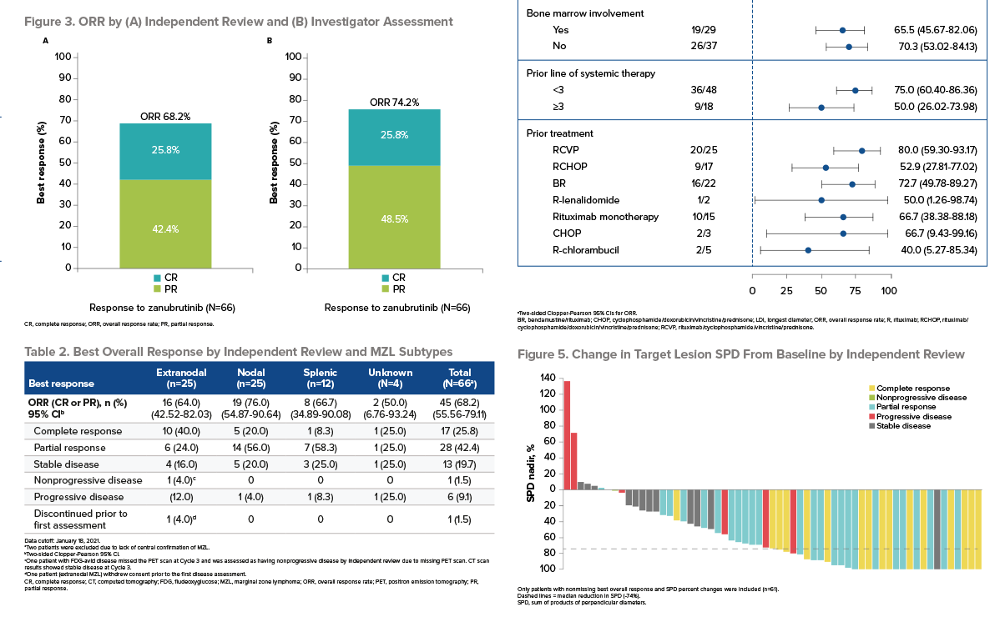
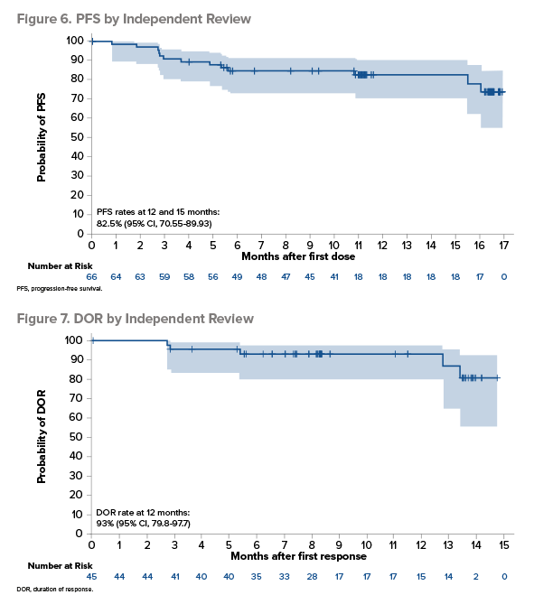
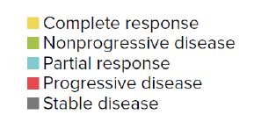

MAGNOLIA (BGB-3111-214): Zanubrutinib in R/R MZL – Response rates
68 patients (26 EMZL, 12 SMZL, 26 NMZL, 4 UNK), ≥1 anti-CD20, median prior LoT: 2; Dose: 160 mg BID Median f-up: 15.7 mo
IRC
INV
ORR 74.2%
ORR 68.2%
DOR
12 mo = 93%
24 mo = 72.9%
25.8%
25.8%
42.4%
48.5%
Same after median f-up: 27.4 mo
PFS
12 & 15 mo = 82.5%
24 mo = 70.9%
Responses across all MZL subtypes
DOR, duration of response; EMZL, extranodal marginal zone lymphoma; f-up, follow-up; INV, investigator; IRC, independent review committee; LoT, line of treatment; mo, months; MZL, marginal zone lymphoma; NMZL, nodal MZL; PFS, progression-free survival; ; SMZL, splenic MZL; UNK, unknown. Adapted from Opat S et al. Blood Adv. 2023;7(22):6801-6811.

Slide 28
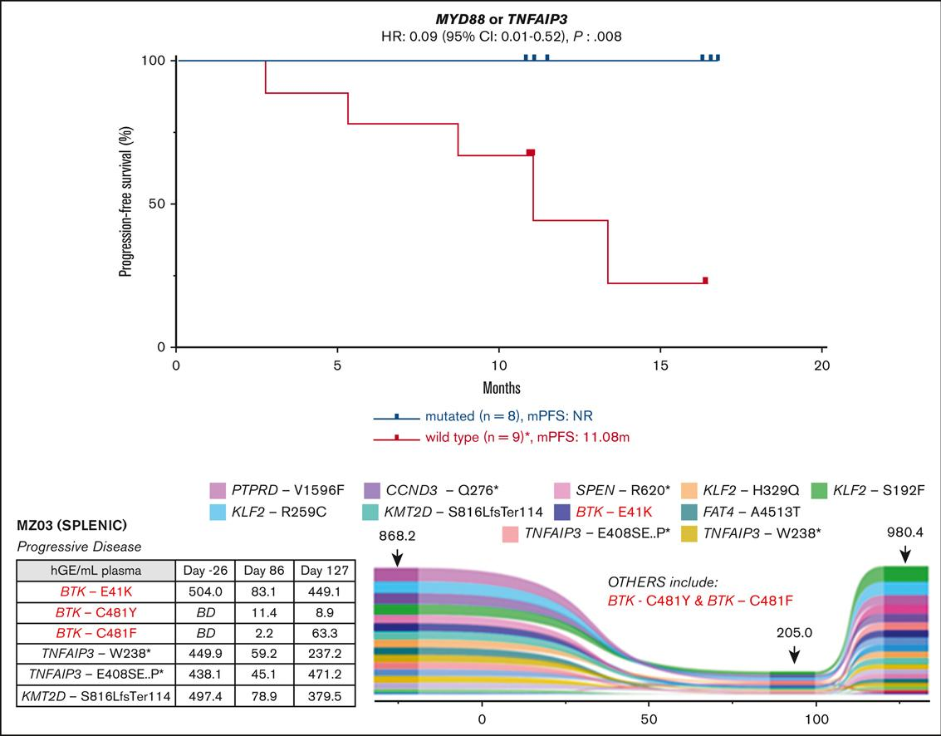
MAGNOLIA (BGB-3111-214): Zanubrutinib in R/R MZL
NOTCH not informative as in MCL and CLL
MYD88 or TNFAIP3 mutations are associated with good response rate
BTK, Bruton's tyrosine kinase; CI, confidence interval; CLL, chronic lymphocytic leukemia; HR, hazard ratio; MCL, mantle cell lymphoma; MZL, marginal zone lymphoma; PFS, progression-free survival; R/R, relapsed/refractory.
Tatarczuch M et al. Blood Adv. 2023;7(14):3531-3539.

Slide 29
TEAEs of Clinical Interest
TEAEs of interest, n (%) | N=68
 | All grade | Grade ≥3
Infections | 38 (56) | 15 (22)ª
Hemorrhage | 28 (41) | 1 (1.5)^{b}
Cardiac
Hypertension | 3 (4)^{c} | 2 (3)
Atrial fibrillation/flutter | 2 (3)^{d} | 1 (1.5)
Ventricular extrasystole | 1 (1.5)^{e} | 0
Second primary malignancy | 5 (7)^{f} | 3 (4)
ªFatal infection: COVID-19 pneumonia (n=2);
^{b}Gastrointestinal hemorrhage (day 862) in a patient who also received anticoagulant for pulmonary embolism; patient continued zanubrutinib with no recurrent bleeding episode.
^{c}Two 2 patients had new-onset hypertension; none led to treatment reduction or discontinuation;
^{d}Atrial fibrillation in a patient with preexisting atrial fibrillation (21 days after end of treatment owing to disease progression). Patient with atrial flutter recovered spontaneously and continued zanubrutinib;
^{e}Ventricular extrasystole in an 83-year-old patient with no known cardiac history, was non-serious, transient, resolved on the same day, and did not lead to treatment modification or discontinuation;
^{f}Includes basal cell and squamous cell carcinoma and basal cell carcinoma (with history of skin cancer); papillary thyroid carcinoma; (with preexisting thyroid nodule); recurrent bladder cancer and prostate cancer (with history of bladder cancer); and acute myeloid leukemia (with prior chemotherapy with alkylating agent).
TEAE, treatment-emergent adverse event.
Adapted from Opat S et al. Blood Adv. 2023;7(22):6801-6811.

Slide 30
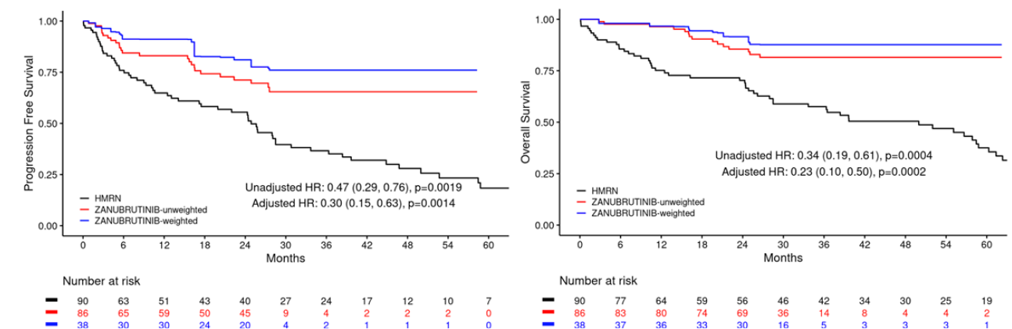
Matching-adjusted indirect comparison of zanubrutinib versus Real-World CIT or chemotherapy in R/R MZL
Matching-adjusted indirect comparison using aggregate data from HMRN and pooled individual patient-level data from MAGNOLIA and BGB-3111-AU-003
Summary: This comparison shows significant PFS and OS benefits for zanubrutinib over CIT or chemo in R/R MZL
PFS and OS Kaplan-Meier results in comparison of MAGNOLIA/BGB-3111-AU-003 (Zanu) and HMRN (CIT or chemo*)
This slide includes data from different clinical trials. These data are meant for demonstration purposes only and are not meant for cross-trial comparison purposes.
*CIT or chemo included the following regimen in order of most to least common: bendamustine/rituximab (30%), single agent rituximab (13%), cyclophosphamide/rituximab+/-steroid (13%), R-CVP (11%), chlorambucil (8%), R-CHOP (4%), FCR (2%), other rituximab (7%), and other non-rituximab (11%).
CIT, chemoimmunotherapy; HMRN, Haematological Malignancy Research Network; HR, hazard ratio; MZL, marginal zone lymphoma; OS, overall survival; PFS, progression-free survival; R/R, relapsed/refractory.
Adapted from Walewska R et al. Matching-adjusted indirect comparison (MAIC) of zanubrutinib versus real-world chemoimmunotherapy (CIT) or chemotherapy (chemo) in relapsed/refractory marginal zone lymphoma (R/R MZL). EHA 2024. Abstract P1123 (Accessed 04 June 2024). Available at: https://library.ehaweb.org/eha/2024/Abstract P1123.

Slide 31
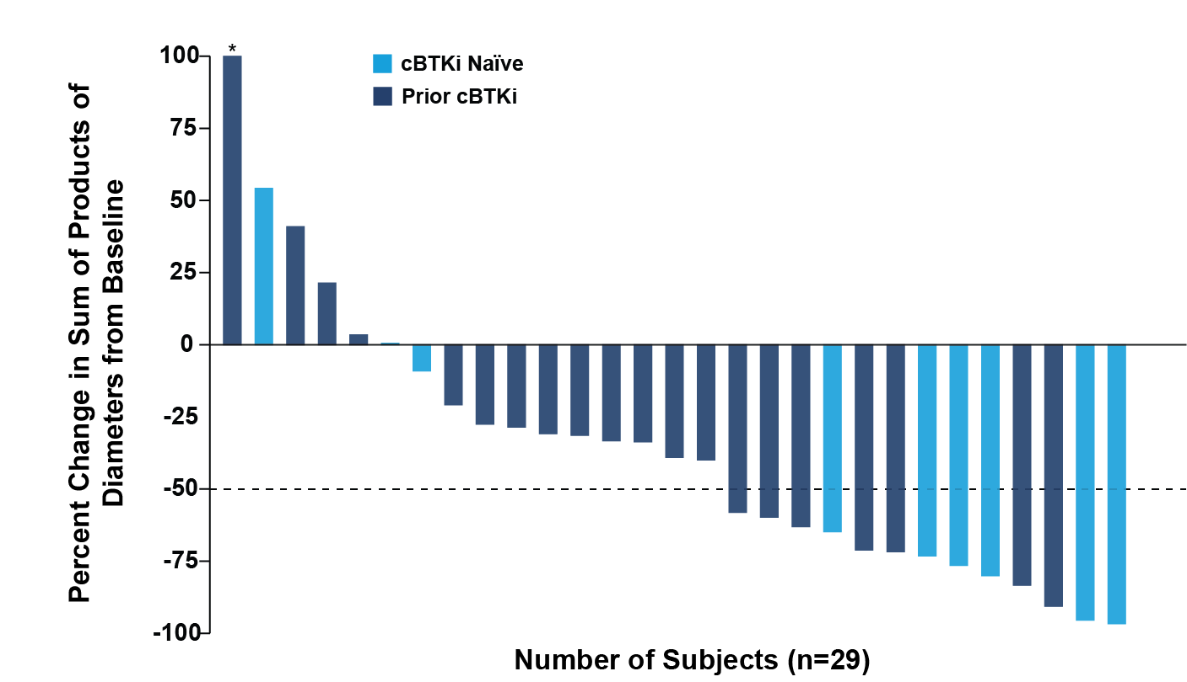
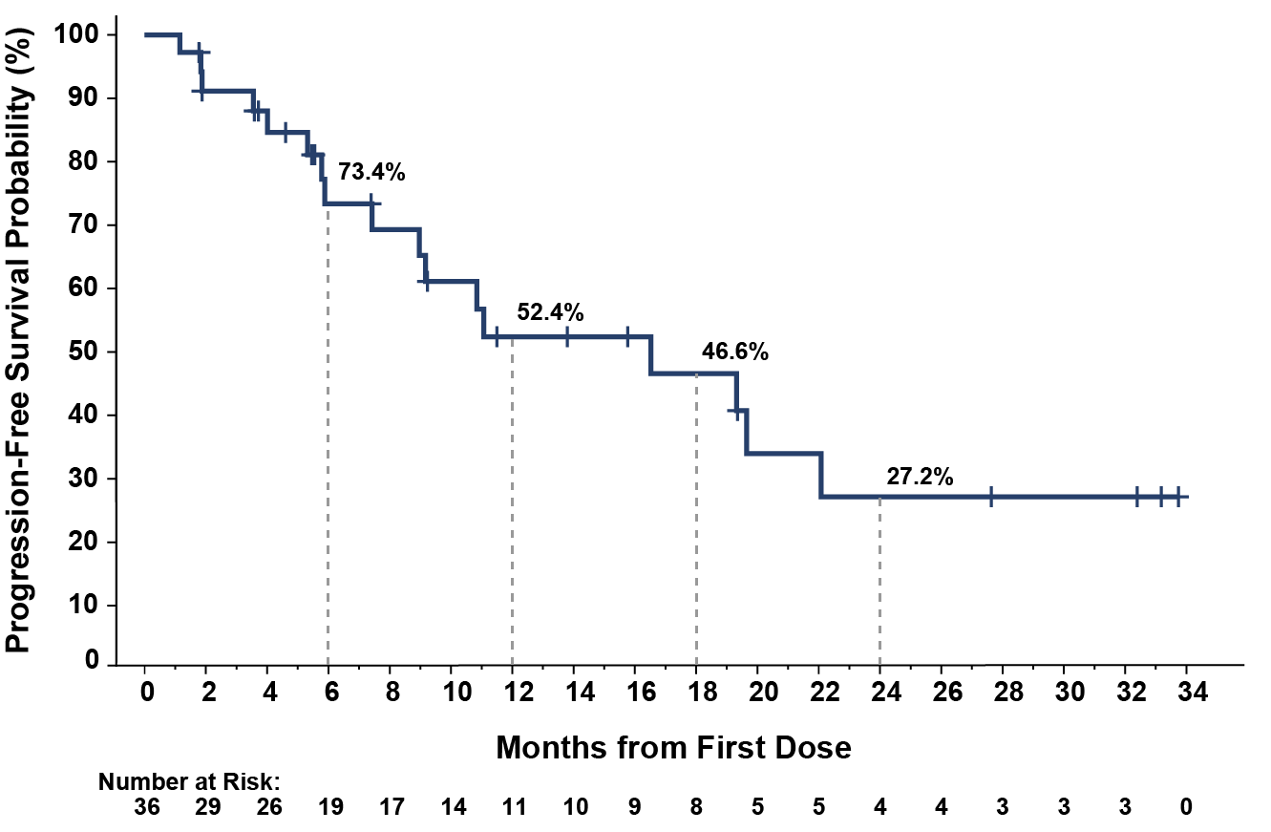
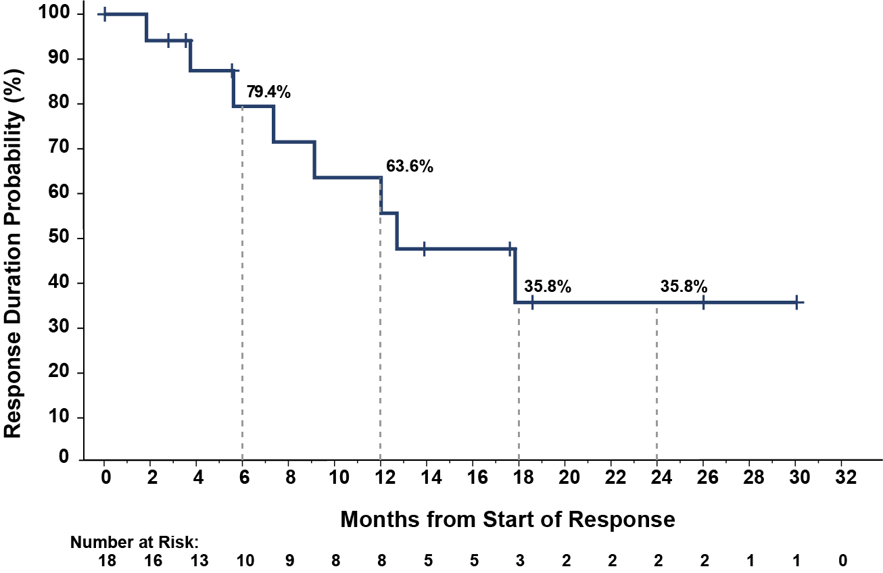
BRUIN study: Pirtobrutinib efficacy in patients with MZL
MZL Subtype, n (%)
Nodal | 17 (47)
Splenic | 13 (36)
Extranodal* | 6 (17)
​ | All MZL Patient n=36 | Prior cBTKi n= 26 | cBTKi Naïve n= 10
Overall Response Rateª, % (95% CI)​ | 50 (32.9- 67.1) | 46.2 (26.6-66.6) | 60.0 (26.2-87.8)
Best Response​, n (%)
CR | 1 (2.8) | 0 (0.0) | 1 (10.0)
PR | 17 (47.2) | 12 (46.2) | 5 (50.0)
Median time-to-response was 1.9 months (range, 1.6-19.3)
Progression-Free Survival
Duration of Response
Data for 7 patients are not shown in the waterfall plot due to no measurable target lesions identified by CT at baseline, discontinuation prior to first response assessment, or lack of adequate imaging in follow-up. *Indicates patient with a > 100% increase in sum of products of diameter, with the corresponding change from baseline of 181.6%. aORR is the number of patients with best response of CR or PR divided by the total number of patients; No patients with a best response of not evaluable (NE) are included in the denominator.
cBTK, covalent Bruton's tyrosine kinase; CI, confidence interval; CR, complete response; MZL, marginal zone lymphoma; PR, partial response.
Patel K et al. Blood. 2023;142 (Supplement 1):1660.

Slide 32
Conclusions
Patients with indolent lymphomas now have effective next-generation BTKi-based treatment options¹
In R/R FL (ROSEWOOD Phase 2 study):
  Zanu + Obi demonstrated meaningful efficacy in heavily pretreated patients²
  Zanu + Obi demonstrated a favorable risk-benefit profile compared with Obi alone²
In R/R MZL (MAGNOLIA Phase 2 study):
  Zanu showed high response rates and durable disease control
  Zanu showed responses in all MZL subtypes and in difficult-to-treat subgroups³
Across these studies, Zanu had a consistent and manageable safety profile^{2,3}
The encouraging results of ROSEWOOD and MAGNOLIA have paved the way for the ongoing MAHOGANY Phase 3 trial
BTKi, Bruton’s tyrosine kinase inhibitor; CLL, chronic lymphocytic leukemia; CR, complete response; CXCR4, C-X-C chemokine receptor 4; EU, European Union; FL, follicular lymphoma; Ibru, ibrutinib; MUT, mutated; MZL, marginal zone lymphoma; Obi, obinutuzumab; ORR, overall response rate; R/R, relapsed/refractory; US, United States (of America); VGPR, very good partial response;
WM, Waldenström’s macroglobulinemia; Zanu, zanubrutinib.
1) Speaker’s own; 2) Zinzani PL et al. J Clin Oncol. 2023;41(33):5107-5117; 3) Sehn LH et al. Presented at 17th International Conference on Malignant Lymphoma, June 13-17, 2023; Lugano, Switzerland; Abstract 994 (Accessed 04 June 2024). Available at: Sehn_BGB-3111-308_ICML_Presentation_2023.pdf.

Slide 33
SCAN QR CODE NOW!
Allows you to:
Ask your questions to the faculty.
Provide your feedback and help BeiGene to better meet your educational needs in the future.

Slide 34



BTKis in Waldenström’s Macroglobulinemia
Christian Buske, MD
Comprehensive Cancer Center,
Ulm, Germany
1024-BGB-3111-MRC-036
Approved: 22 October 2024

Slide 35
Disclosures
COI | Sponsor
Research support/P.I | Roche, Janssen​, Bayer, MSD, Amgen, Celltrion, AbbVie, Pfizer
Honoraria | Roche, Pfizer, Janssen​, Hexal, Celltrion, AbbVie, Novartis, Bayer, Morphosys, Regeneron, BeiGene, Gilead, Lilly
COI, conflict of interest.

Slide 36
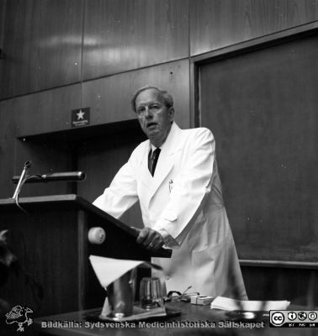
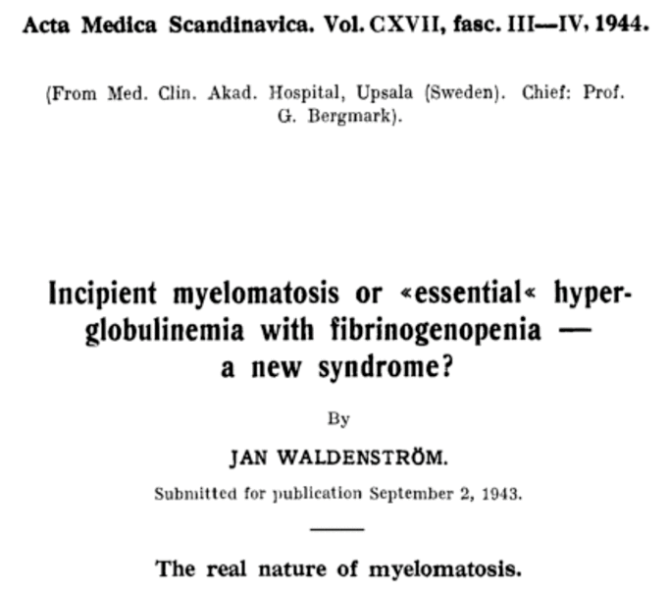
As it started - 80th anniversary
36

Slide 37
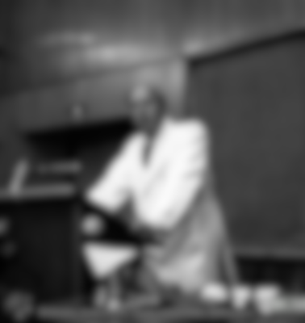
Waldenström‘s Macroglobulinemia
Let‘s refresh our minds for a second

Slide 38
Where are we now………. and what are our challenges?
Challenge 1:
cBTKi may be less active in MYD88^{WT} and CXCR4^{MUT} cases
cBTKi, covalent Bruton’s tyrosine kinase inhibitor; CXCR4, C-X-C chemokine receptor 4; MUT, mutated; MYD88, myeloid differentiation primary response 88; WT, wild type.
Treon SP et al. Blood. 2014;123(18):2791-6.

Slide 39
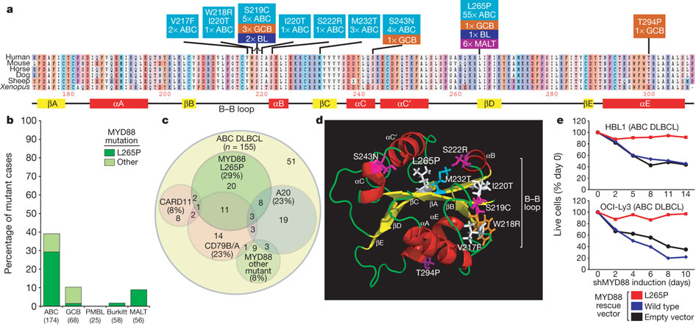
MYD88 mutation
Treon et al:
Whole Genome Seq. of 30 WM patients, validated by Sanger Seq.
Sanger Seq. identified MYD88 L265P in 90% of patients
(27/30 WM samples)
22/26 patients were heterozygous for MYD88 L265P
9/9 patients with familial WM carried mutant MYD88 L265P
2/21 patients with IgM-MGUS had MYD88 L265P expression
→ 95-97 % of all patients positive!
3-D structure of MY88 TIR domain
Base pair mismatch Leuc → Pro at position 265 in MYD88 coding region
MYD88, myeloid differentiation primary response 88; WM, Waldenström’s macroglobulinemia.
1) Treon SP et al. N Engl J Med. 2012;367(9):826-33; 2) Ngo VN et al. Nature. 2011;470(7332):115-9.

Slide 40
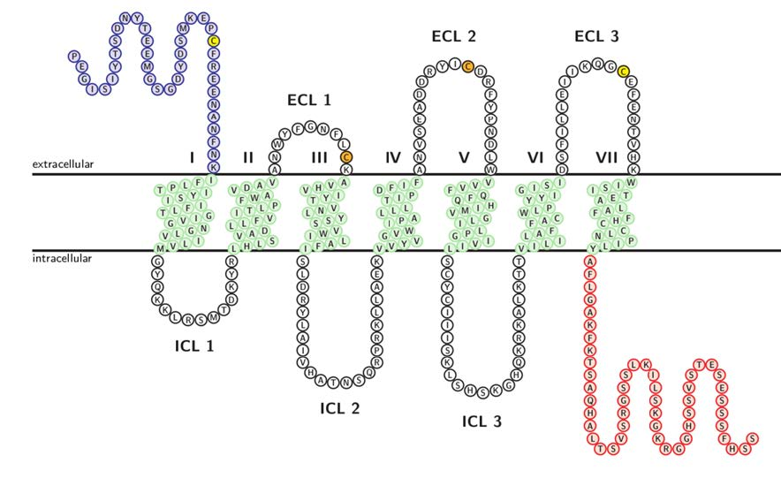
CXCR4 receptor C-terminal domain (WHIM-like) mutations are common in WM
CXCL12
CXCR4 mutations
Non-sense
Frameshift
Most common mutation is S338X
352
30-40% of WM patients
S338X
CXCR4, C-X-C chemokine receptor 4; WHIM, warts, hypogammaglobulinemia, infections, and myelokathexis; WM, Waldenström’s macroglobulinemia.
Adapted from 1) Kahler A and Sticht H. AIMS Biophysics. 2016;3(2):211-231; 2) Hunter ZR et al. Blood. 2014;123(11):1637–1646; 3) Poulain S et al. Clin Cancer Res. 2016;22(6):1480-8.

Slide 41
Waldenström’s macroglobulinemia:
WM is a heterogenous disease!
Molecular Markers
Any implications?
WM, Waldenström’s macroglobulinemia.

Slide 42
Waldenström’s macroglobulinemia:
WM is a heterogenous disease!
Molecular Markers
Three prognostic groups:
MYD88^{MUT} / CXCR4^{WT}
MYD88^{MUT} / CXCR4^{MUT}
MYD88^{WT} / CXCR4^{WT}
CXCR4, C-X-C chemokine receptor 4; MYD88, myeloid differentiation primary response 88; PR, partial response; VGPR, very good partial response; WM, Waldenström’s macroglobulinemia; WT, wild type.
Treon SP et al. Blood. 2014;123(18):2791-6.

Slide 43
Waldenström‘s macroglobulinemia
What about treatment in 2024:
Our national guidelines

Slide 44
German/Austrian/Swiss guidelines on treatment of WM – first-line
* Not suitable for CIT
WM, Waldenström’s macroglobulinemia.
Adapted from Onkopedia WM Guideline 2022. Available at: https://www.onkopedia.com/de/onkopedia/guidelines/morbus-waldenstroem-lymphoplasmozytisches-lymphom/@@guideline/html/index.html.

Slide 45
German/Austrian/Swiss guidelines on treatment of WM – relapsed/refractory
unfit
WM, Waldenström’s macroglobulinemia.
Adapted from Onkopedia WM Guideline 2022. Available at: https://www.onkopedia.com/de/onkopedia/guidelines/morbus-waldenstroem-lymphoplasmozytisches-lymphom/@@guideline/html/index.html.

Slide 46
German/Austrian/Swiss Guidelines on treatment of WM
In summary:
cBTKis are everywhere
cBTKis dominate in the R/R setting
cBTKi, covalent Bruton’s tyrosine kinase inhibitor; R/R, relapsed/refractory; WM, Waldenström’s macroglobulinemia.
Adapted from Onkopedia WM Guideline 2022. Available at: https://www.onkopedia.com/de/onkopedia/guidelines/morbus-waldenstroem-lymphoplasmozytisches-lymphom/@@guideline/html/index.html.

Slide 47
Waldenström‘s macroglobulinemia
When and how to use cBTKis in 2024?
The mutational status of
MYD88 and CXCR4 is important
cBTKi, covalent Bruton’s tyrosine kinase inhibitor; CXCR4, C-X-C chemokine receptor 4; MYD88, myeloid differentiation primary response 88.

Slide 48
Waldenström’s macroglobulinemia:
WM is a heterogenous disease!
MYD88 and CXCR4
Any implications?
Ibrutinib
CXCR4, C-X-C chemokine receptor 4; MYD88, myeloid differentiation primary response 88; WM, Waldenström’s macroglobulinemia.

Slide 49
Schema for multi-center Phase 2 study of ibrutinib in relapsed/refractory WM (NCT01614821)
Screening
N=63
Informed Consent and Registration
Ibrutinib
420 mg po daily
Progressive Disease or Unacceptable Toxicity
Stable Disease or Response
Continue x 26 four-week cycles
Stop Ibrutinib
Event Monitoring
Event Monitoring
ENROLMENT MAY 2012 – JUN 2013
DFCI, MSKCC, STANFORD
DFCI, Dana-Farber Cancer Institiute; MSKCC, Memorial Sloan Kettering Cancer Center; po, oral; WM, Waldenström’s macroglobulinemia.
Treon SP et al. N Engl J Med. 2015 Apr 9;372(15):1430-40.

Slide 50
Responses to ibrutinib are impacted by MYD88
(L265P and non-L265P) and CXCR4 mutations
 | MYD88^{MUT} CXCR4^{WT} | MYD88^{MUT} CXCR4^{WHIM} | MYD88^{WT} CXCR4^{WT} | p-value
N= | 36 | 21 | 5
Overall RR | 100% | 85.7% | 60% | <0.01
Major RR | 91.7% | 61.9% | 0% | <0.01
2 patients subsequently found to have other MYD88 mutations not picked up by AS-PCR
AS-PCR, allele-specific polymerase-chain-reaction; CXCR4, C-X-C chemokine receptor 4; MUT, mutated; MYD88, myeloid differentiation primary response 88; RR, response rate; WHIM, warts, hypogammaglobulinemia, infections, and myelokathexis; WT, wild type.
Treon SP et al. N Engl J Med. 2015;373:584-586; NEJM 2015; Letter to Editor, August 6, 2015.
50

Slide 51
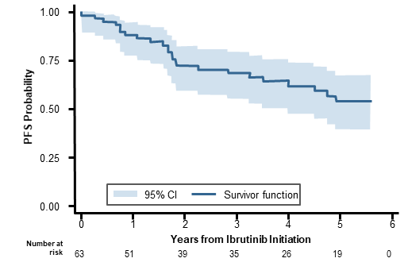

Ibrutinib activity in previously treated WM:
Updated PFS of the pivotal trial (median F/U 59 months)
All patients
MYD88 and CXCR4 Mutation Status
1.00
Log-rank P < 0.001
0.75
MYD88^{MUT}/ CXCR4^{WT}
PFS Probability
0.50
MYD88^{MUT}/ CXCR4^{MUT}
0.25
MYD88^{WT}/ CXCR4^{WT}
0.00
0
1
2
3
4
5
6
Years from Ibrutinib Initiation
Number at risk
MUT/WT
MUT/MUT
WT/WT
36
22
4
34
16
1
26
13
0
25
10
0
18
8
0
14
5
0
0
0
0
5-year PFS: 54%
5-year OS: 87%
CXCR4, C-X-C chemokine receptor 4; MUT, mutated; F/U, follow-up; MYD88, myeloid differentiation primary response 88; OS, overall survival; PFS, progression-free survival;
WM, Waldenström’s macroglobulinemia.
Adapted from Treon SP et al. J Clin Oncol. 2021;39(6):565-575.

Slide 52
Take-home messages – ibrutinib single agent
(Speaker’s opinion)
In CXCR4^{MUT} patients think about alternatives
→ See next slides on zanubrutinib and I/R
In MYD88^{WT} patients do not use if possible
CXCR4, C-X-C chemokine receptor 4; I/R, ibrutinib+rituximab; MUT, mutated; MYD88, myeloid differentiation primary response 88; WT, wild type.

Slide 53
Waldenström’s macroglobulinemia:
WM is a heterogenous disease!
MYD88 and CXCR4
Any implications?
Zanubrutinib
CXCR4, C-X-C chemokine receptor 4; MYD88, myeloid differentiation primary response 88; WM, Waldenström’s macroglobulinemia.

Slide 54
ASPEN is an open‑label, multicenter, randomized Phase 3 study of zanubrutinib vs ibrutinib in patients with WM
Cohort 1
Arm A: Zanubrutinib
n=102
160 mg BID until PD
98
Eligible Patients
Histologic diagnosis of WM
Meeting ≥1 criterion for treatment initiation
If treatment naïve,
must be considered unsuitable for standard chemoimmunotherapy
No prior BTK inhibitors
Patients with
MYD88^{MUT} WM
N=201 (164 R/R)
Methodology
Pretreatment bone marrow aspirates without enrichment
152-gene panel with
0.1%-0.25% sensitivity
Multivariate analyses: correlation between genetic alterations and treatment responses
R
1:1
Arm B: Ibrutinib
n=99
420 mg QD until PD
92
Cohort 2
Patients with
MYD88^{WT} WM
N=28 (23 R/R)
Arm C: Zanubrutinib
N=28
160 mg BID until PD
20
ClinicalTrials.gov: NCT03053440
EU Clinical Trial Register: EUDRACT 2016-002980-33
Stratiﬁcation Factors
CXCR4 status (CXCR4^{MUT} vs CXCR4^{WT}/missing)
Number of prior lines of therapy (0 vs 1-3 vs >3)
Evaluable NGS results (n)
MYD88 status was assessed by a PCR-based assay, with 0.2%-0.5% LOD which was used for patients’ enrollment. CXCR4 status was evaluated by sanger sequencing with 10%-15% sensitivity for stratification factors and tested by 152-gene NGS panel with 0.1%-0.25% sensitivity for biomarker analysis.
Clinical efficacy endpoints include
  Response rates (CR+VGPR, major responses)
  Time to response
  PFS assessed according to response criteria in the NCCN® WM guidelines and modified Owen criteria¹ by investigator
BID, twice a day; BTK, Bruton tyrosine kinase; CR, complete response; CXCR4, C-X-C chemokine receptor type 4; LOD, limit of detection; MUT, mutated; MYD88, myeloid differentiation primary response 88; NCCN, National Comprehensive Cancer Network; NGS, next-generation sequencing; PCR, polymerase chain reaction; PD, progressive disease; PFS, progression-free survival; QD, once a day; R/R, relapsed/refractory; VGPR, very good partial response; WT, wild type; WM, Waldenström macroglobulinemia.
1) Dimopoulos MA et al. Presented by Constantine Tam at the 11th IWWM; October 27-30, 2022; Session XI: Plenary Session II, Presentation WM041. Available at: Dimopoulos_BGB-3111-302_Biomarker_IWWM_Presentation_2022.pdf; 2) Dimopoulos MA et al. J Clin Oncol. 2023;41(33):5099-5106.
54
Notes:
Highlight
MYD88 mutation for pts enrollment was tested by PCR-based assay with 0.2%-0.5% LOD
CXCR4 mutation for stratification was tested by sanger sequencing with 10%-15% LOD
CXCR4 mutations were also tested by NGS 152-gene panel with 0.25% LOD for biomarker analysis
FQA and answer:
Why CXCR4mut for stratification purpose used sanger PCR but for biomarker analysis used 152-gene panel? (A: sanger sequencing detected lower CXCR4 mutation rate than literature after pts enrollment, ad-hoc testing with high sensitive 152-gene panel increased the CXCR4 mutation detection rate, and found more CXCR4 mutation enrolled in zanu arm compared to ibru arm)

Slide 55
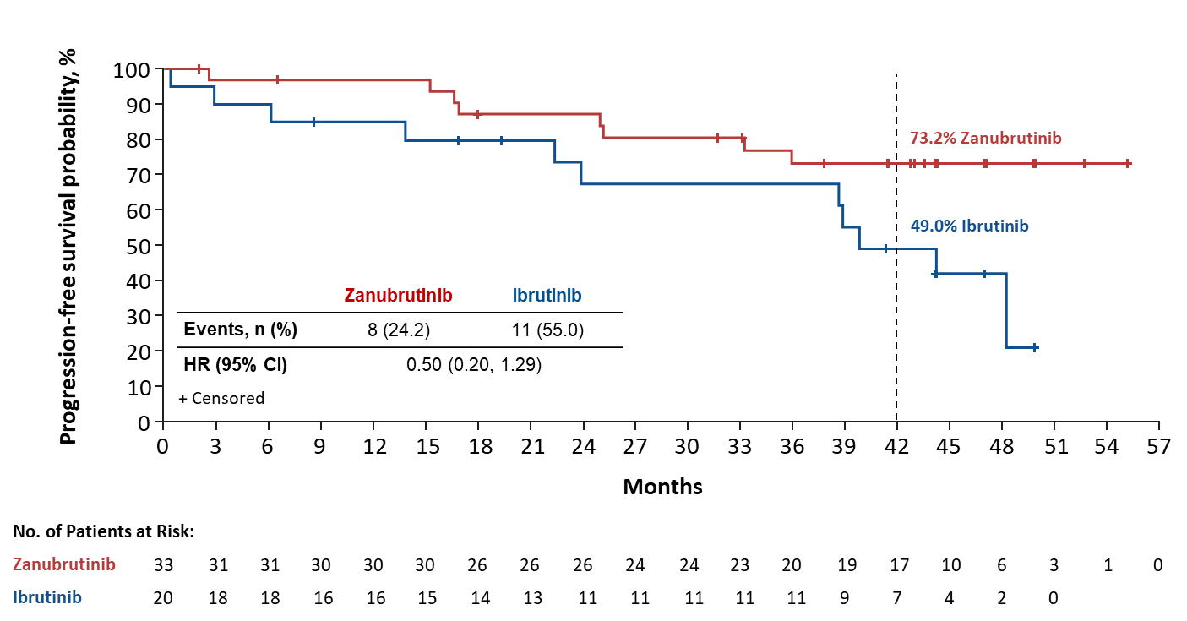
Response and PFS in patients with MYD88^{MUT} by CXCR4 status
ASPEN Phase 3 trial: zanubrutinib vs ibrutinib in WM
Response Assessment by CXCR4 Statusª
PFS in Patients with MYD88^{MUT}CXCR4^{MUT}
Response | CXCR4^{MUT} |  | CXCR4^{WT} | Cohort 2
AE Categories, n (%) | Ibrutinib (n=20) | Zanubrutinib (n=33) | Ibrutinib (n=72) | Zanubrutinib (n=65)
VGPR or better, n (%) | 2 (10.0) | 7 (21.2) | 22 (30.6) | 29 (44.6)
Major response, n (%) | 13 (65.0) | 26 (78.8) | 61 (84.7) | 54 (83.1)
Overall response, n (%) | 19 (95.0) | 30 (90.9) | 68 (94.4) | 63 (96.9)
Median time to major response, median (months) | 6.6 | 3.4 | 2.8 | 2.8
Median time to VGPR, median (months) | 31.3 | 11.1 | 11.3 | 6.5
73.2% zanubrutinib
49.0% ibrutinib
Bold blue text indicates >10% difference between arms
Data cutoff: October 31, 2021.
ªCXCR4 mutation determined by NGS. 92 ibrutinib patients and 98 zanubrutinib patients had NGS results available.
CI, confidence interval; CXCR4, C-X-C chemokine receptor 4; HR, hazard ratio; MUT, mutated; MYD88, myeloid differentiation primary response 88; PFS, progression-free survival; VGPR, very good partial response; WT, wild type.
1) Dimopoulos MA et al. Presented at the 11th IWWM; October 27-30, 2022; Session XI: Plenary Session II, Presentation WM042. Available at: Dimopoulos_BGB-3111-302_IWWM_Presentation_2022.pdf; 2) Dimopoulos MA et al. J Clin Oncol. 2023;41(33):5099-5106.
55

Slide 56
Best overall response by investigator over time – MYD88^{WT}
Responses Over Time Observed in MYD88^{WT}
100
3.8
3.8
3.8
PD
90
19.2
15.4
15.4
SD
80
MR
15.4
70
23.1
26.9
PR
60
VGPR
Patients, %
34.6
CR
50
40
26.9
23.1
MRR
30
65%
20
26.9
26.9
30.8
10
0
0
0
3.8
Zanubrutinib
Zanubrutinib
Zanubrutinib
mFU
17.9 months
28.9 months
42.9 months
Data cutoff: October 31, 2021.
CR, complete response; CXCR4, C-X-C chemokine receptor type 4; mFU, median follow-up; MR, major response; MRR, major response rate; MYD88, myeloid differentiation primary response 88;
PD, progressive disease; PR, partial response; SD, stable disease; VGPR, very good partial response; WT, wild type.
1) Dimopoulos MA et al. Presented at the 11th IWWM; October 27-30, 2022; Session XI: Plenary Session II, Presentation WM042. Available at: Dimopoulos_BGB-3111-302_IWWM_Presentation_2022.pdf;
2) Dimopoulos MA et al. J Clin Oncol. 2023;41(33):5099-5106.
56
Notes:
In cohort 1, the investigator‑assessed cumulative response rate increased over time in both treatment arms
No complete responses (CR) were observed in cohort 1. Response rate of CR + very good partial response (VGPR) was numerically higher at all time points with zanubrutinib compared with ibrutinib
At 44.4-month median follow‑up, CR+VGPR rates by investigator were 36.3% (zanubrutinib) vs 25.3% (ibrutinib)
Median time to CR+VGPR was shorter for zanubrutinib: 6.7 months (range, 1.9‑42.0) vs ibrutinib: 16.6 months (range, 2.0‑49.9)
Event‑free rate for the duration of CR+VGPR at 24 months was higher for zanubrutinib: 90.6% (range, 73.6‑96.9) vs ibrutinib: 79.3% (range, 53.5‑91.8)
In cohort 2 (MYD88^{WT}), zanubrutinib demonstrated a CR in 1 patient with a major response rate of 65% (including 31% CR+VGPR) overall

Slide 57
Take home messages – zanubrutinib single agent
(Speaker’s opinion)
In CXCR4^{MUT} patients, zanubrutinib is the preferred cBTKi over ibrutinib
In MYD88^{WT} patients, zanubrutinib is the treatment of choice if you want to use single agent cBTKi
cBTKi, covalent Bruton’s tyrosine kinase inhibitor; CXCR4, C-X-C chemokine receptor 4; MUT, mutated; MYD88, myeloid differentiation primary response 88; WT, wild type.

Slide 58
Waldenström’s macroglobulinemia:
WM is a heterogenous disease!
MYD88 and CXCR4
Any implications?
Any other approaches beyond cBTKi monotherapy?
Ibrutinib/rituximab
cBTKi, covalent Bruton’s tyrosine kinase inhibitor; CXCR4, C-X-C chemokine receptor 4; MYD88, myeloid differentiation primary response 88; WM, Waldenström’s macroglobulinemia.

Slide 59
iNNOVATE (PCYC-1127) study design
Key eligibility criteria
Confirmed WMª (N≈150)
Measurable disease
(serum IgM >0.5 g/dL)
RTX sensitive
  Not refractory to last prior RTX-based therapy
  Had not received RTX
  <12 months before first study dose
1:1 Randomization
Stratification
IPSSWM (low vs intermediate vs high)
Number of prior regimens (0 vs 1–2 vs ≥3)
ECOG PS (0–1 vs 2)
Arm A
Ibrutinib-RTX
Oral ibrutinib 420 mg once daily until PD
RTX 375 mg/m² IV on
day 1 of weeks 1–4 and 17–20
Arm B
Placebo-RTX
Placebo until PD
RTX 375 mg/m² IV on
day 1 of weeks 1–4 and 17–20
Crossover to single-agent ibrutinib allowed after PD^{b}
Endpoints: PFS and response rates by IRC, OS, Hgb improvement, TTNT, safety
At study closure, patients without PD could continue ibrutinib in an extension program
ECOG PS, Eastern Cooperative Oncology Group performance status; Hgb, hemoglobin; IgM, immunoglobulin M; IPSSWM, International Prognosis Scoring System for Waldenström’s Macroglobulinemia; IRC, independent review committee; IV, intravenous; OS, overall survival; PD, progressive disease; RTX, rituximab; TTNT, time to next treatment.
ªTreatment-naive patients were allowed to enroll following a protocol amendment (November 2015); therefore, their enrollment started later than relapsed patients.
^{b}Patients in the placebo-RTX arm could receive next-line single-agent ibrutinib in crossover following IRC-confirmed PD.
iNNOVATE Study; ClinicalTrials.gov ID: NCT02165397.
Buske C et al. J Clin Oncol. 2022;40(1):52-62.

Slide 60
Median progression-free survival was not reached with
5 years of ibrutinib-RTX – ITT Population
100
54-month PFS rate: 68% vs 25%
90
80
Ibrutinib-RTX
70
60
Progression-Free Survival, %
50
40
Placebo-RTX
30
20
 | Ibrutinib-RTX | Placebo-RTX
Median PFS, mo | Not reached | 20.3
HR (95% CI) | 0.250 (0.148−0.420)
Log-rank P-value | <0.0001
10
0
0
3
6
9
12
15
18
21
24
27
30
33
36
39
42
45
48
51
54
57
60
Months
Patients at risk
Ibrutinib-RTX
75
73
69
67
66
60
60
58
57
56
54
54
46
48
47
44
32
22
15
7
Placebo-RTX
75
64
54
48
43
39
33
32
31
27
23
19
19
17
17
15
7
4
3
2
CI, confidence interval; HR, hazard ratio; ITT, intent-to-treat; mo, months; PFS, progression-free survival; RTX, rituximab.
Buske C et al. J Clin Oncol. 2022;40(1):52-62.

Slide 61
Progression-free survival benefit with ibrutinib-RTX was independent of genotype
100
90
80
MYD88^{L265P}/CXCR4^{WT}
70
MYD88^{WT}/
CXCR4^{WT}
Ibrutinib-RTX
60
MYD88^{L265P}/CXCR4^{WHIM}
Progression-Free Survival, %
50
40
MYD88^{WT}/CXCR4^{WT}
30
MYD88^{L265P}/
CXCR4^{WT}
Placebo-RTX
20
10
MYD88^{L265P}/CXCR4^{WHIM}
0
0
3
6
9
12
15
18
21
24
27
30
33
36
39
42
45
48
51
54
57
60
Months
Patients at risk
Ibrutinib-RTX MYD88^{L265P}/CXCR4^{WHIM}
26
26
25
24
23
20
20
20
20
19
17
17
13
13
13
13
8
7
5
Ibrutinib-RTX MYD88^{L265P}/CXCR4^{WT}
32
31
29
29
29
27
27
26
25
25
25
25
24
23
22
19
15
8
5
Ibrutinib-RTX MYD88^{WT}/CXCR4^{WT}
11
10
9
8
8
8
8
8
8
8
8
8
8
8
8
8
6
5
3
Placebo-RTX MYD88^{L265P}/CXCR4^{WHIM}
23
20
17
16
14
11
10
9
9
8
6
4
4
4
4
4
2
1
1
Placebo-RTX MYD88^{L265P}/CXCR4^{WT}
35
28
23
20
17
17
15
15
15
14
12
10
10
8
8
7
3
1
1
Kaplan-Meier curves are shown for timepoints with ≥10 patients at risk.
Placebo-RTX MYD88^{WT}/CXCR4^{WT}
9
8
6
6
6
6
5
5
4
4
4
4
4
4
4
3
2
2
1
CXCR4, C-X-C chemokine receptor type 4; MYD88, myeloid differentiation primary response 88; RTX, rituximab; WHIM, warts, hypogammaglobulinemia, infections, and myelokathexis; WT, wild type.
Buske C et al. J Clin Oncol. 2022;40(1):52-62.

Slide 62
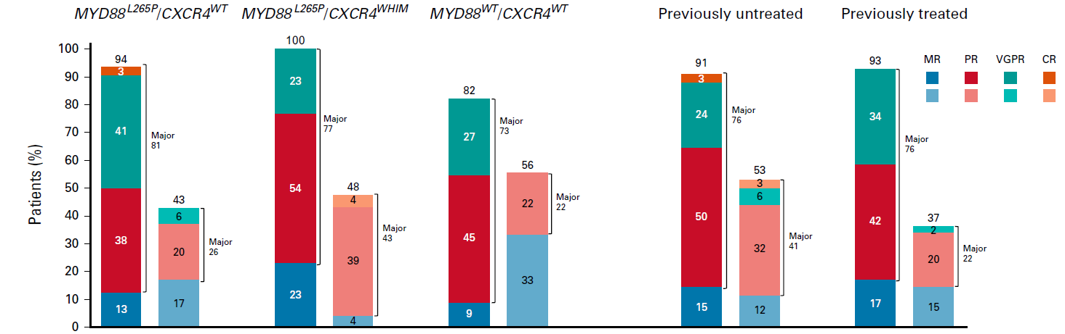
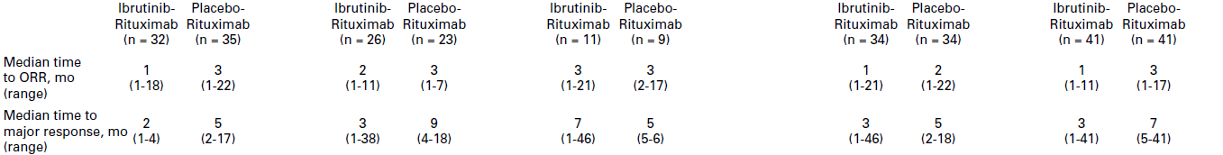
Higher response rates with ibrutinib-RTX independent of genotype or prior treatment status
CR, complete response; CXCR4, C-X-C chemokine receptor type 4; mo, months; MR, minor response; MYD88, myeloid differentiation primary response 88; ORR, overall response rate; PR, partial response; RTX, rituximab; VGPR, very good partial response; WHIM, warts, hypogammaglobulinemia, infections, and myelokathexis; WT, wild type.
Buske C et al. J Clin Oncol. 2022;40(1):52-62.

Slide 63
Take home messages – ibrutinib/rituximab
(Speaker’s opinion)
In CXCR4^{MUT} and MYD88^{WT} patients, I/R is preferred over single agent ibrutinib
I/R versus zanubrutinib? No direct comparison, BUT single agent zanubrutinib more convenient and most likely better tolerated than I/R
In situations where zanubrutinib is not available, I/R may be an important treatment tool
CXCR4, C-X-C chemokine receptor 4; I/R, ibrutinib/rituximab; MUT, mutated; MYD88, myeloid differentiation primary response 88; WT, wild type.

Slide 64
Waldenström’s macroglobulinemia:
WM is a heterogenous disease!
TP53 alterations?
Any implications?
TP53, tumor protein p53; WM, Waldenström’s macroglobulinemia.

Slide 65
High Rates of TP53^{MUT} in WM in the ASPEN Study
In zanubrutinib-treated vs ibrutinib-treated MYD88^{MUT} cohorts, the CXCR4^{NS} rate is 14.2% (14/98) vs 14.1% (13/92), and the CXCR4^{FS} rate is 19.4% (19/98) vs 7.6%(7/92), respectively
Mutation rate, % (n) | MYD88^{WT} (n=20) | MYD88^{MUT} (n=190) | CXCR4^{WT} (n=156) | CXCR4^{MUT} (n=54) | CXCR4^{FS} (n=27) | CXCR4^{NS} (n=27)
TP53 | 4 (20%) | 48 (25.3%) | 33 (21.2%) | 19 (35.2%) | 8 (29.6%) | 11 (40.7%)
TERT | 0 | 19 (10%) | 6 (3.9%) | 13 (24.1%) | 4 (14.8%) | 9 (33.3%)
ARID1A | 1 (5%) | 31 (16.3%) | 9 (5.8%) | 23 (42.6%) | 11 (40.7%) | 12 (44.4%)
TN/RR status
BOR_INV (31Oct2021)
Discontinuation before 1st assessment
TN
CR
MR
RR
VGPR
SD
PR
PD
Mutation type
deletion
fusion
not detected
splice site
frameshift
missense
multiple alterations
promoter
nonsense
amplification
Bold text indicates >10% difference between MUT and WT in 210 NGS-evaluable patients with WM.
ªIncluding 190 patients with MYD88^{MUT} (98 treated by zanubrutinib, and 92 treated by ibrutinib) and 20 patients with MYD88^{WT} (all zanubrutinib), MYD88 status was assessed by a PCR-based assay which was used for patients’ enrollment. CXCR4 status was evaluated by NGS.
BOR, best overall response; CR, complete response; CXCR4, C-X-C chemokine receptor type 4; FS, frameshift; INV, investigator; MR, major response; MYD88, myeloid differentiation primary response 88; NGS, next-generation secquencing; NS, nonsense; PD, progressive disease; PR, partial response; RR, relapsed/refractory; SD, stable disease; VGPR, very good partial response; TERT, telomerase reverse transcriptase gene; TN, treatment naïve; TP53, tumor protein P53; WM, Waldenström macroglobulinemia; WT, wild type.
Dimopoulos MA et al. Presented by Constantine Tam at the 11th IWWM; October 27-30, 2022; Session XI: Plenary Session II, Presentation WM041. Available at: Dimopoulos_BGB-3111-302_Biomarker_IWWM_Presentation_2022.pdf.
65
Notes:
Highlight
TP53^{MUT} and TERT^{MUT} were detected at high rate (24.8% and 9.1% separately) in additional to most common mutated genes CXCR4^{MUT} (25.7%), ARID1A^{MUT} (15.2%)
TERT mutations are localized on promoter, it’s first time to report TERT promoter mutations.
More CXCR4 ^{FS} was enrolled in zanu arm compared to ibru arm, CXCR4^{FS} rate in zanu- vs ibru- is 19.4% (19/98) vs 7.6% (7/92)
TP53^{MUT}rate was similar is MYD88^{MUT} vs MYD88^{WT} but tend to be higher in CXCR4^{MUT} vs CXCR4^{WT,} especially in CXCR4^{NS}
TERT^{MUT} and ARID1A^{MUT} were more often detected in patients with MYD88^{MUT} and associated with a higher rate of CXCR4^{MUT} ,TERTMUT were more detected in CXCR4^{NS}
FQA and answer:
Why higher TP53 mutation was detected in ASPEN but not in other literatures? (A: ASPEN used higher sensitivity NGS panels and enrolled more RR patients compared to previous studies which used less sensitive assays such as allele specific PCR, Sanger sequencing, or targeted sequencing approaches and enrolled more TN patients)
Hypothesis about TERT mutation in WM? (A: TERT promoter mutations can enhance TERT transcription and were found in multiple cancer types including in ~30% MCL; TERT activation promotes tumor progression through maintain telomere length, activating wnt/b-catenin pathway, activating NFKB pathway; even TERT function in WM is unknown but its downstream NFKB pathway is activated in WM. TERT mutations in WM need to be validated in other independent WM cohort, and its function in WM need to be further studied)

Slide 66
Zanubrutinib showed deeper responses vs ibrutinib in TP53^{MUT} WM
Response | Patients with MYD88^{MUT} treated with ibrutinib |  | Patients with MYD88^{MUT} treated with zanubrutinib
 | TP53^{WT} (n=70) | TP53^{MUT} (n=22) | TP53^{WT} (n=72) | TP53^{MUT} (n=26)
VGPR or better, n (%) | 21 (30.0) | 3 (13.6) | 27 (37.5) | 9 (34.6)
MR, n (%) | 60 (85.7)* | 14 (63.6)* | 59 (81.9) | 21 (80.8)
Median time to VGPR or better (min, max), months | 11.4 (2.0, 49.9) | 24.9 (5.6, 46.9) | 6.5 (1.9, 42.0) | 11.1 (3.0, 26.0)
Median time to MR (min, max), months | 2.9 (0.9, 49.8) | 3.0 (1.0, 13.8) | 2.8 (0.9, 49.8) | 2.8 (1.0, 5.6)
Data cutoff: October 31, 2021.
Bold text indicates >10% difference between MUT and WT. Bold red text highlights P value < 0.05.
*P value <0.05, based on a logistic regression model with CXCR4 (WT, FS, NS), TP53 (WT, MUT), and TERT (WT, MUT) statuses as covariates. WT is the reference group.
ªMutation determined by NGS and available for 92 patients in the ibrutinib arm and 98 patients in the zanubrutinib arm. ^{b}Includes the number of progressive disease or death.
^{c}Estimated using a Cox regression model with CXCR4 (WT, FS, NS), TP53 (WT, MUT), and TERT (WT, MUT) mutational status as covariates. WT is the reference group.
MR, major response; MUT, mutated; PFS, progression-free survival; MYD88, myeloid differentiation primary response 88; NGS, next-generation sequencing; TERT, telomerase reverse transcriptase gene; TP53, tumor protein P53; VGPR, very good partial response; WM, Waldenström’s macroglobulinemia; WT, wild type.
Dimopoulos MA et al. Presented by Constantine Tam at the 11th IWWM; October 27-30, 2022; Session XI: Plenary Session II, Presentation WM041. Available at: Dimopoulos_BGB-3111-302_Biomarker_IWWM_Presentation_2022.pdf.
66
Notes:
Highlight:
TP53^{MUT} pts had significantly lower MRR than TP53^{WT}, and trended toward a lower VGPR+CR rate than TP53^{WT}
similar VGPR+CR rate and MRR between TP53^{MUT} and TP53^{WT} subgroups with zanubrutinib
TP53^{MUT} pts had longer time to VGPR+CR than TP53^{WT} regardless of treatment, but zanu showed faster responses than ibru in TP53^{MUT}
Significant worse PFS in TP53^{MUT} vs TP53^{WT} by ibrutinib, zanu showed favorable PFS than ibrutinib in TP53^{MUT}

Slide 67
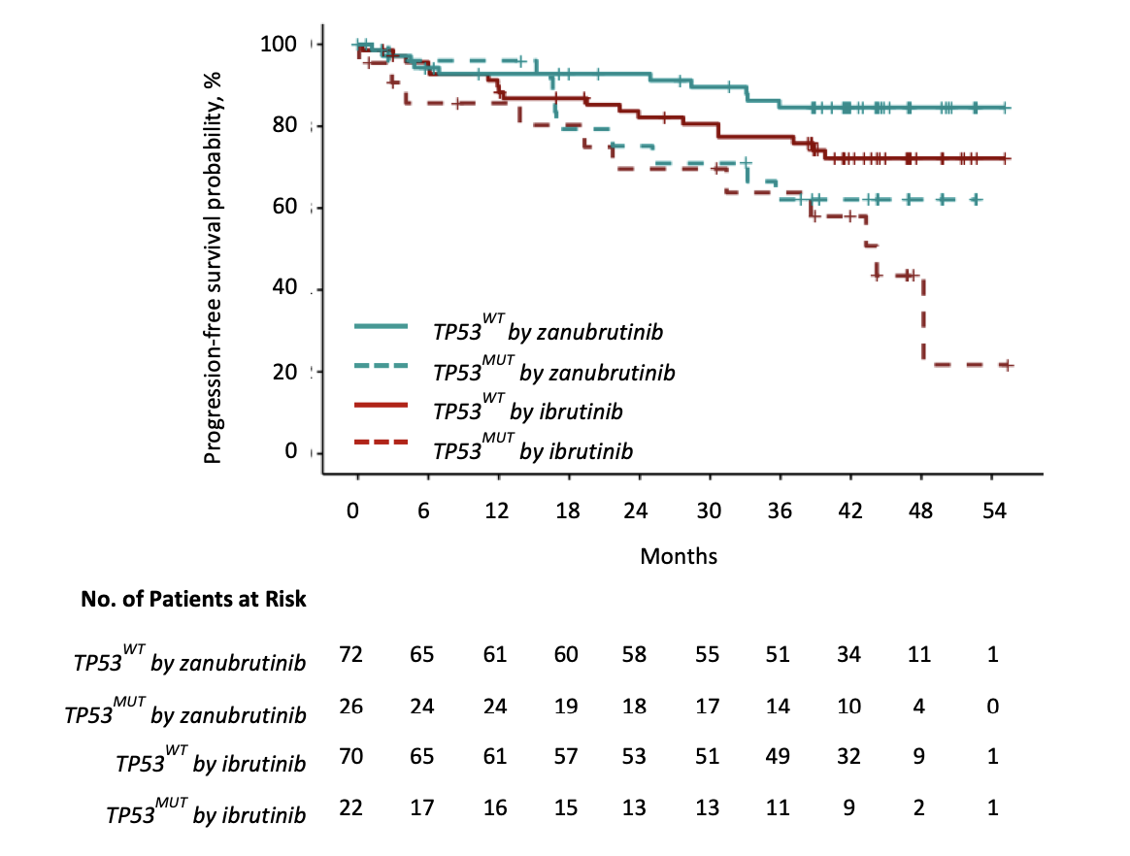
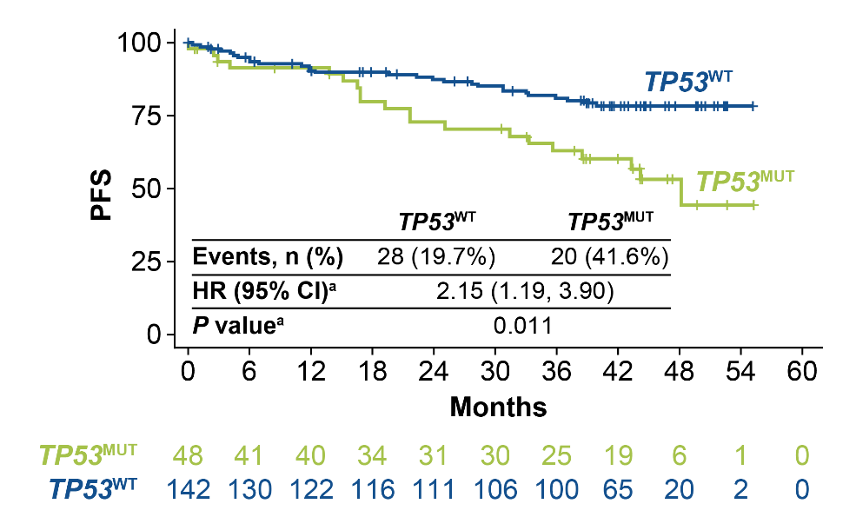
Patients with TP53^{MUT} trended toward less favorable PFS than patients with the respective WT alleles
PFS by TP53 Mutational Status
Data cutoff: October 31, 2021.
Pooled analysis of patients with MYD88MUT WM from cohort 1 including 98 treated by zanubrutinib and 92 treated by ibrutinib.
ªHR and P values were estimated using a Cox regression model with CXCR4 (WT, MUT), TP53 (WT, MUT), and TERT (WT, MUT) mutational statuses as covariates. WT is the reference group.
CXCR4, C-X-C chemokine receptor type 4; HR, hazard ratio; MUT, mutated; PFS, progression-free survival; TERT, telomerase reverse transcriptase gene; TP53, tumor protein P53;
WM, Waldenström macroglobulinemia; WT, wild type.
Dimopoulos MA et al. Presented by Constantine Tam at the 11th IWWM; October 27-30, 2022; Session XI: Plenary Session II, Presentation WM041. Available at: Dimopoulos_BGB-3111-302_Biomarker_IWWM_Presentation_2022.pdf.
67
Notes:
Highlight
Patients with CXCR4^{MUT}, TP53^{MUT} , TERT^{MUT} trended toward less favorable PFS than patients with the respective WT alleles

Slide 68
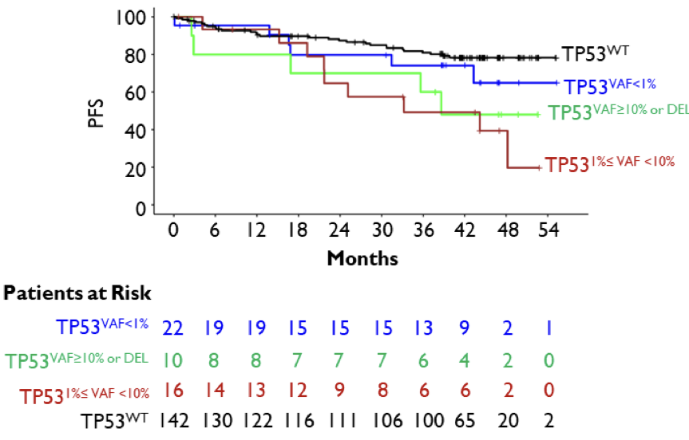
PFS outcome depends on the size of the TP53^{MUT} clone
TP53 Mutational VAF and PFS
Data cutoff: October 31, 2021.
DEL, deletion; MUT, mutated; PFS, progression-free survival; TP53, tumor protein P53; VAF, variant allele frequency; WT, wild type.
Dimopoulos MA et al. Presented by Constantine Tam at the 11th IWWM; October 27-30, 2022; Session XI: Plenary Session II, Presentation WM041. Available at: Dimopoulos_BGB-3111-302_Biomarker_IWWM_Presentation_2022.pdf.
68
Notes:
Highlight
Patients with CXCR4^{MUT}, TP53^{MUT} , TERT^{MUT} trended toward less favorable PFS than patients with the respective WT alleles

Slide 69
Take-home messages – TP53 alterations
(Speaker’s opinion)
Not routinely measured
Data still limited
No robust data on impact on outcomes with immunochemotherapy
If TP53 alterations present, based on the ASPEN data set, use preferentially zanubrutinib as cBTKi
cBTKi, covalent Bruton’s tyrosine kinase inhibitor; TP53, tumor protein p53.

Slide 70
Waldenström‘s macroglobulinemia
New Developments

Slide 71
Efficacy of Pirtobrutinib, a Highly Selective, Non-Covalent (Reversible) BTK Inhibitor in Relapsed/Refractory Waldenström Macroglobulinemia:
Results from the Phase 1/2 BRUIN Study
Lydia Scarfò (Presenter)¹, M Lia Palomba², Manish R. Patel³, Toby A. Eyre⁴, Wojciech Jurczak⁵, David Lewis⁶, Thomas Gastinne⁷, Shuo Ma⁸, Jonathon B. Cohen⁹, Krish Patel¹⁰, Jennifer R. Brown¹¹, Talha Munir¹², Ewa Lech-Maranda¹³, Marc S. Hoffmann¹⁴, Chaitra S. Ujjani¹⁵, Bita Fakhri¹⁶, Michael Wang¹⁷, Koji Izutsu¹⁸, Hirokazu Nagai¹⁹, Constantine S. Tam²⁰, John F. Seymour²⁰, Joanna M. Rhodes²¹, Julie Vose²², Matthew McKinney²³, James N. Gerson²⁴, Minal A. Barve²⁵, Bryone Kuss²⁶, Youngil Koh²⁷,
Wei Gao²⁸, Amy S. Ruppert²⁸, Richard A. Walgren²⁹, Donald E. Tsai²⁹, Binoj Nair²⁹, Katherine Bao²⁹, Anthony R. Mato²,
Chan Y. Cheah³⁰
¹Università Vita-Salute San Raffaele and IRCCS Ospedale San Raffaele, Milan, Italy; ²Memorial Sloan Kettering Cancer Center, New York, NY, USA; ³Florida Cancer Specialists, Sarah Cannon Research Institute, Sarasota, FL, USA; ⁴Churchill Cancer Center, Oxford University Hospitals NHS Foundation Trust, Oxford, UK; ⁵Maria Sklodowska-Curie National Institute of Oncology, Krakow, Poland; ⁶Plymouth Hospitals NHS Trust - Derriford Hospital, Plymouth, UK; ⁷Centre Hospitalier Universitaire de Nantes, Nantes, France; ⁸Robert H. Lurie Comprehensive Cancer Center, Feinberg School of Medicine, Northwestern University, Chicago, IL, USA; ⁹Winship Cancer Institute, Emory University, Atlanta, GA, USA; ¹⁰Swedish Cancer Institute, Seattle, WA, USA; ¹¹Dana-Farber Cancer Institute and Harvard Medical School, Boston, MA, USA; ¹²Department of Haematology, St. James’s University Hospital, Leeds, UK; ¹³Institute of Hematology and Transfusion Medicine, Warsaw, Poland; ¹⁴The University of Kansas Cancer Center, Kansas City, KS, USA; ¹⁵Fred Hutchinson Cancer Center, University of Washington, Seattle, WA, USA; ¹⁶University of California San Francisco Medical Center, San Francisco, CA, USA; ¹⁷University of Texas, MD Anderson Cancer Center, Houston, TX, USA; ¹⁸National Cancer Center Hospital, Tokyo, Japan; ¹⁹National Hospital Organization Nagoya Medical Center, Nagoya, Japan; ²⁰Peter MacCallum Cancer Center, Royal Melbourne Hospital, University of Melbourne, Melbourne, Australia; ²¹Northwell Health Cancer Institute, New Hyde Park, NY, USA; ²²University of Nebraska Medical Center, Omaha, NE, USA; ²³Duke Cancer Institute, Durham, NC, USA; ²⁴Lymphoma Program, Abramson Cancer Center, University of Pennsylvania, Philadelphia, USA; ²⁵Mary Crowley Cancer Research Center, Dallas, TX, USA; ²⁶Flinders University Medical Centre, Bedford Park, Australia; ²⁷Seoul National University Hospital, Seoul, South Korea; ²⁸Eli Lilly and Company, Indianapolis, IN, USA; ²⁹Loxo@Lilly, Indianapolis, IN, USA; ³⁰Linear Clinical Research and Sir Charles Gairdner Hospital, Perth, Australia
Presented at the EHA2023 Hybrid Congress; June 08-11, 2023; Frankfurt, Germany (Abstract P1108)
71

Slide 72
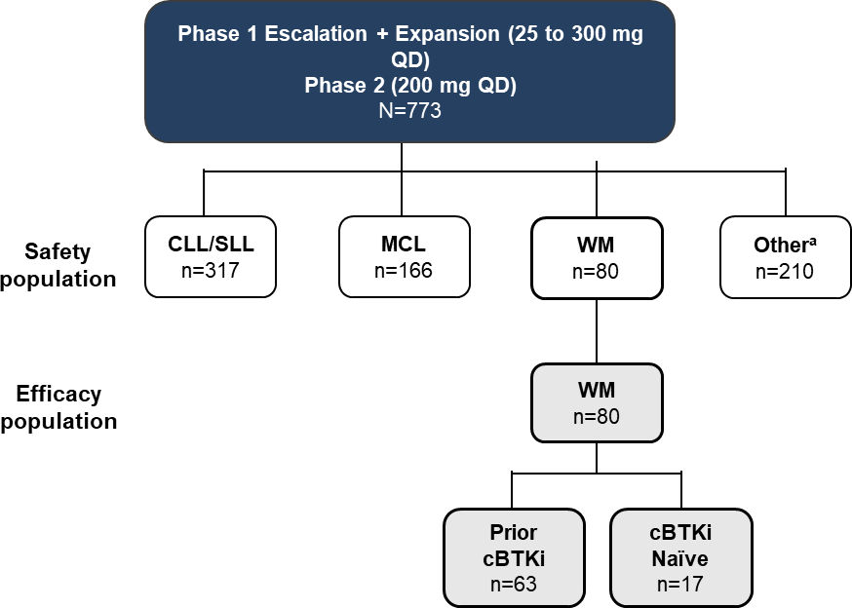
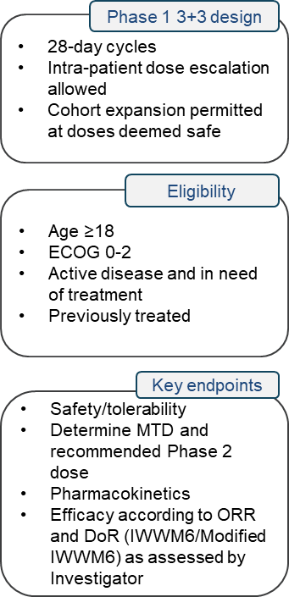
Phase 1/2 BRUIN study: Design, eligibility and enrollment
Background
Scarfò, et al.; EHA 2023 (Lead: Jonathon Cohen]
Data cutoff date: 29 July 2022.
ªOther includes DLBCL, Richter transformation, FL, MZL, B-PLL, Hairy Cell Leukemia, PCNSL, and other transformation.
cBTKi, covalent Bruton’s tyrosine kinase inhibitor; CLL, chronic lymphocytic leukemia; DoR, duration of response; ECOG, Eastern Cooperative Oncology Group; IWWM, International Workshop on Waldenström’s macroglobulinemia; MCL, mantle cell lymphoma; MTD, maximum tolerated dose; ORR, overall response rate; QD, once daily; SLL, small lymphocytic leukemia;
WM, Waldenström’s macroglobulinemia.
Scarfò L et al. EHA 2023; Abstract P1108.

Slide 73
Phase 1/2 BRUIN study: Patient characteristics
Background
Scarfò, et al.; EHA 2023 (Lead: Jonathon Cohen]
BCL2, B-cell lymphoma-2; cBTKi, covalent Bruton’s tyrosine kinase inhibitor; CIT, chemoimmunotherapy; ECOG PS, Eastern Cooperative Oncology Group performance status; PI3K, phosphoinositide 3-kinases.
Scarfò L et al. EHA 2023; Abstract P1108.

Slide 74
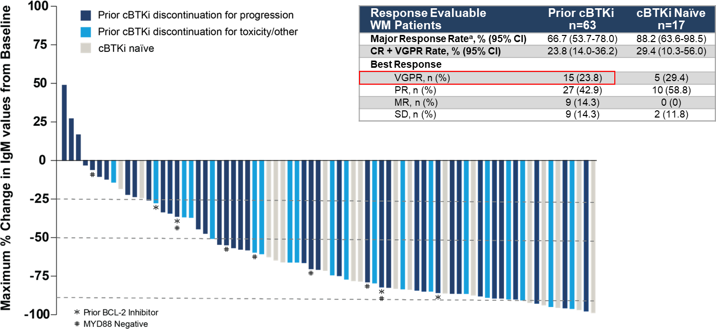
Phase 1/2 BRUIN study: Pirtobrutinib efficacy in WM patients
Background
Scarfò, et al.; EHA 2023 (Lead: Jonathon Cohen]
Data cutoff date of 29 July 2022. Data for 4 patients are not shown in the waterfall plot due to missing IgM values at baseline or response assessment. Response as assessed by investigator based on Modified IWWM6 (Owen’s) criteria. Under modified IWWM6 criteria, a PR is upgraded to VGPR if corresponding IgM is in normal range or has at least 90% reduction from baseline. ªMajor response includes subjects with a best response of CR, VGPR, or PR. Total % may be different than the sum of the individual components due to rounding.
BCL2, B-cell lymphoma-2; cBTKi, covalent Bruton’s tyrosine kinase inhibitor; CI, confidence interval; CR, complete response; MR, major response MYD88, myeloid differentiation primary response 88; PR, partial response; SD, stable disease; VGPR, very good partial response; WM, Waldenström’s macroglobulinemia
Scarfò L et al. EHA 2023; Abstract P1108.

Slide 75
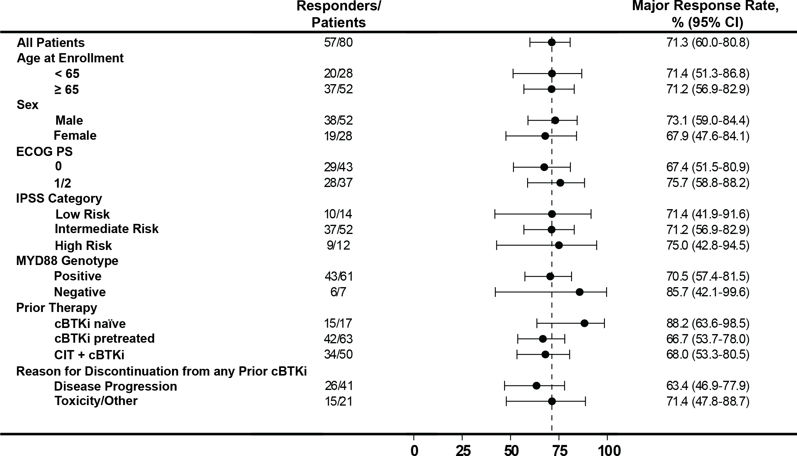
Phase 1/2 BRUIN study: Major response rate in WM subgroups
Background
Scarfò, et al.; EHA 2023 (Lead: Jonathon Cohen]
Data cutoff date of 29 July 2022. Response as assessed by investigator based on modified IWWM6 criteria.
cBTKi, covalent Bruton’s tyrosine kinase inhibitor; CI, confidence interval; CIT, chemoimmunotherapy; ECOG PS, Eastern Cooperative Oncology Group performance status; IPSS, International Prognostic Scoring System; IWWM, International Workshop on Waldenström’s macroglobulinemia; MYD88, myeloid differentiation primary response 88.
Scarfò L et al. EHA 2023; Abstract P1108.

Slide 76
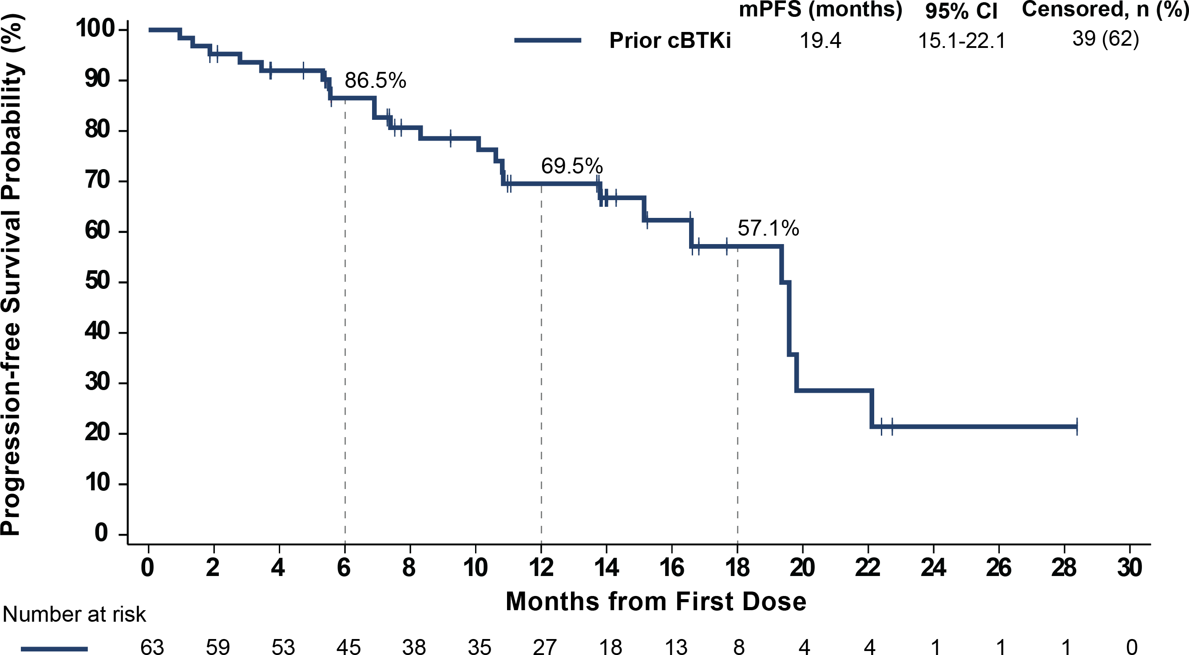
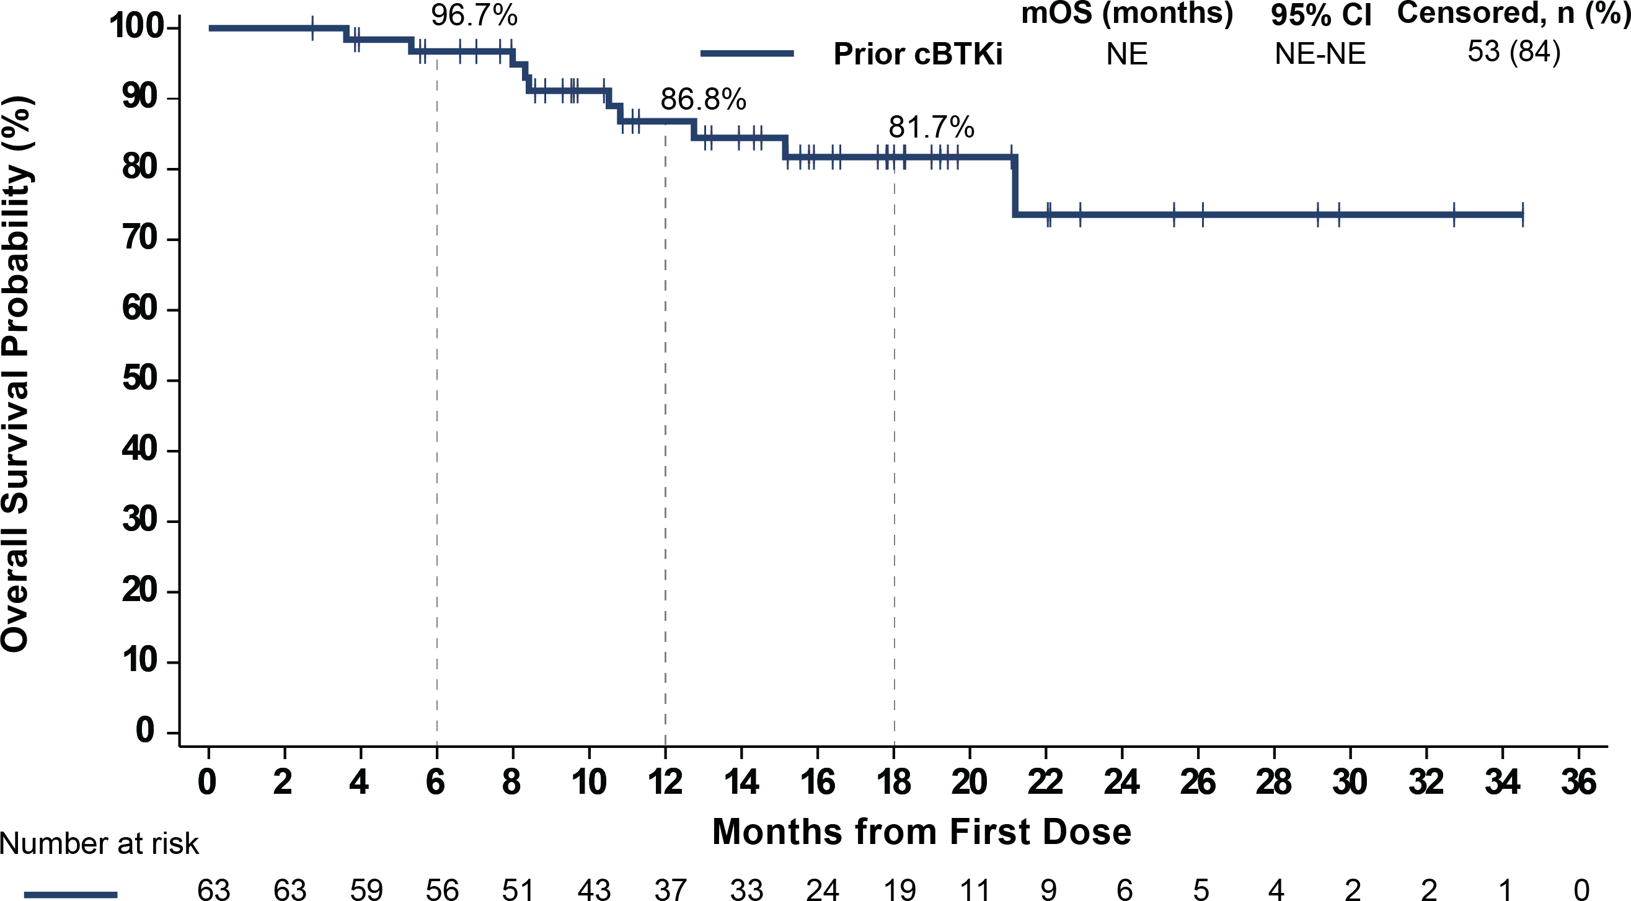
Phase 1/2 BRUIN study: PFS and OS in prior cBTKi patients
Background
Progression-free survival
Overall survival
Scarfò, et al.; EHA 2023 (Lead: Jonathon Cohen]
The median follow-up for PFS and OS in patients who received prior cBTKi was 14 and 16 months, respectively
55.6% (35/63) of patients who received prior cBTKi remain on pirtobrutinib
Data cutoff date of 29 July 2022. Response as assessed by investigator based on modified IWWM6 criteria.
cBTKi, covalent Bruton’s tyrosine kinase inhibitor; CI, confidence interval; NE, not estimable; OS, overall survival; PFS, progression-free survival.
Scarfò L et al. EHA 2023; Abstract P1108.

Slide 77
Phase 1/2 BRUIN study: Pirtobrutinib safety profile
Background
Scarfò, et al.; EHA 2023 (Lead: Jonathon Cohen]
Median time on treatment for the overall safety population was 9.6 months
Discontinuations due to treatment-related AEs occurred in 2.6% (n=20) of all patients
Dose reductions due to treatment-related AEs occurred in 4.5% (n=35) of all patients
Overall and WM safety profiles are generally consistent^{h}
Data cutoff date of 29 July 2022. ªAggregate of neutropenia and neutrophil count decreased. ^{b}AEs of special interest are those that were previously associated with covalent BTK inhibitors. ^{c}Aggregate of contusion, petechiae, ecchymosis, and increased tendency to bruise. ^{d}Aggregate of all preferred terms including rash. ^{e}Aggregate of all preferred terms including hematoma or hemorrhage. ^{f}Aggregate of atrial fibrillation and atrial flutter. ^{g}Of the 22 total afib/aflutter TEAEs in the overall safety population, 7 occurred in patients with a prior medical history of atrial fibrillation. ^{h}Constipation is more commonly seen as a TEAE in the WM population than in all patients.
Afib/aflutter, atrial fibrillation/atrial flutter; AE, adverse event; TEAE, treatment-emergent AE; WM, Waldenström’s macroglobulinemia.
Scarfò L et al. EHA 2023; Abstract P1108.

Slide 78
Overall conclusions (Speaker’s own)
  WM is a heterogeneous disease
  cBTKis are mainstays of therapy, especially in the R/R setting
  MYD88 and CXCR4 mutation status influence response to cBTKi therapy
  Zanubrutinib benefit over ibrutinib especially seen in CXCR4^{MUT}, MYD88^{WT} and TP53^{MUT}
  Ibr-RTX outperformed RTX and may be preferable to ibrutinib in CXCR4^{MUT} and MYD88^{WT}
  Zanubrutinib vs Ibr-RTX: no direct comparison, but single agent zanubrutinib more convenient and likely better tolerated
  ncBTKi pirtobrutinib Phase 1/2 data in WM are encouraging
BTKi, Bruton’s tyrosine kinase inhibitor; cBTKi,covalent BTKi; CXCR4, C-X-C chemokine receptor 4; Ibr, ibrutinib; MUT, mutated; MYD88, myeloid differentiation primary response 88; nc, non-covalent BTKi;
RTX, rituximab; R/R, relapsed/refractory; TP53, tumor protein p53; WT, wild type; WM, Waldenström’s macroglobulinemia.

Slide 79
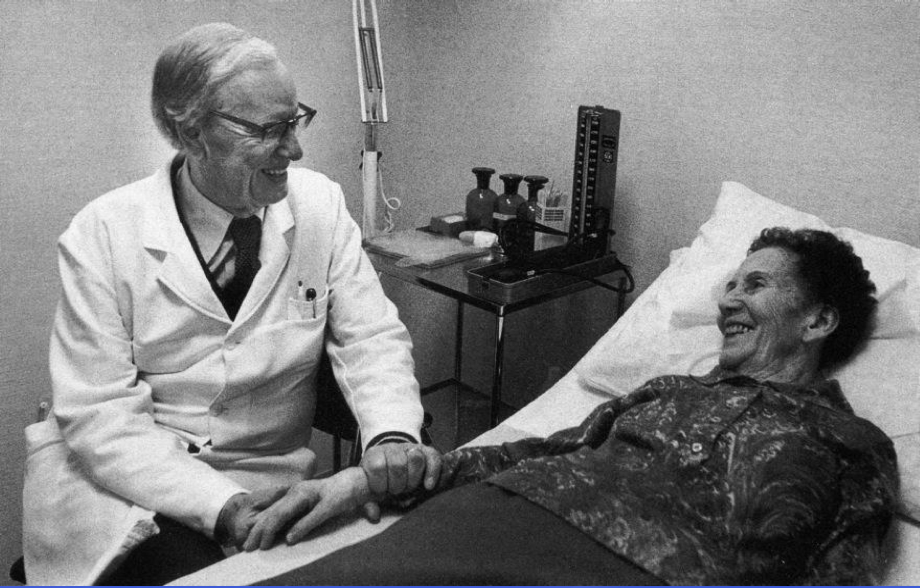
The future looks bright!
Thank you!
79

Slide 80
SCAN QR CODE NOW!
Allows you to:
Ask your questions to the faculty.
Provide your feedback and help BeiGene to better meet your educational needs in the future.

Slide 81
BTKi in MCL
David Lewis, MD
University Hospitals NHS Trust,
Plymouth, UK
1024-BGB-3111-MRC-015
Approved: 17 October 2024

Slide 82
Disclosures
COI | Sponsor
Honoraria | BeiGene, AbbVie, J&J, AstraZeneca, Roche, Kite, Eli Lilly
Research funding | J&J
Advisory boards | J&J, AbbVie, AstraZeneca, Roche
Speakers’ bureau | J&J, AbbVie, AstraZeneca, Roche, BeiGene, Eli Lilly
COI, conflict of interest.

Slide 83
Introduction
I will summarise the key data on BTKi in MCL
Where are we with R/R MCL?
Bringing BTKi into first-line therapy of MCL
Can we improve on BTKi in R/R MCL?
BTKi, Bruton’s tyrosine kinase inhibitor; MCL, mantle cell lymphoma; R/R, relapsed/refractory

Slide 84
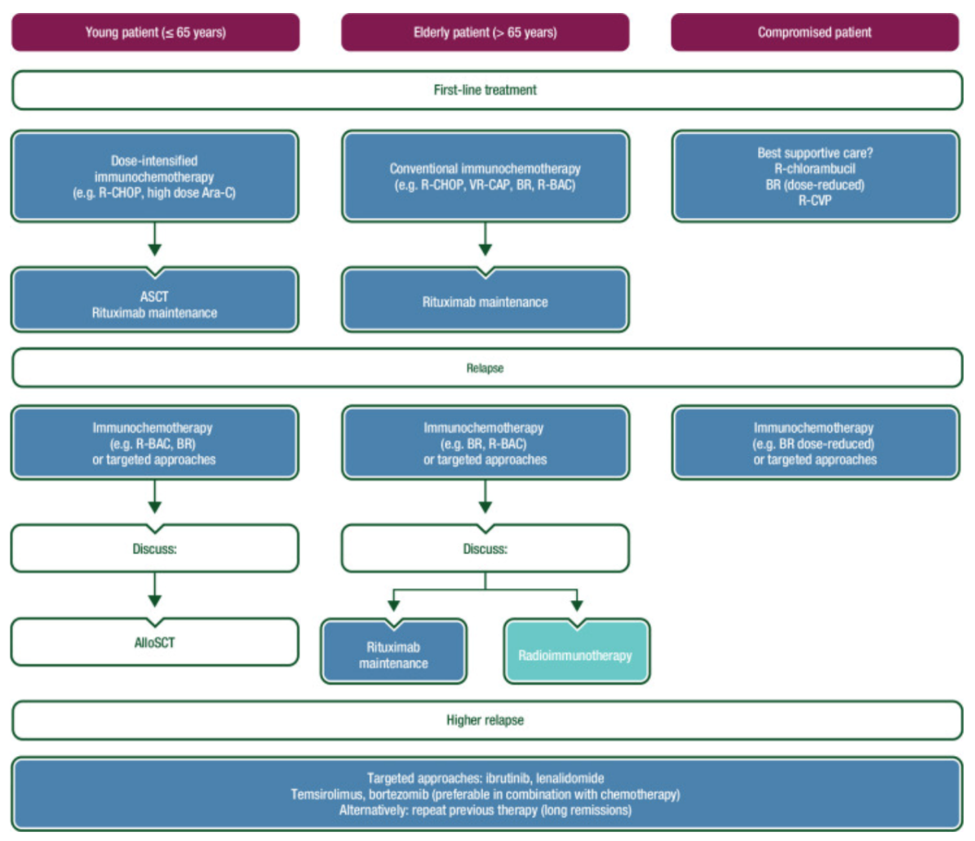
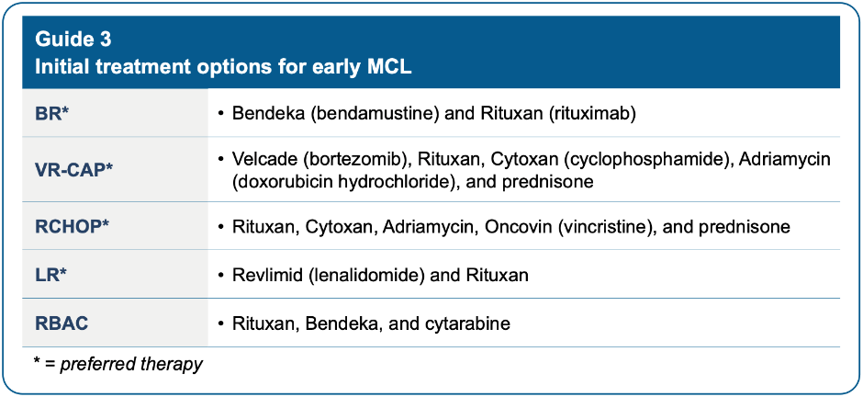
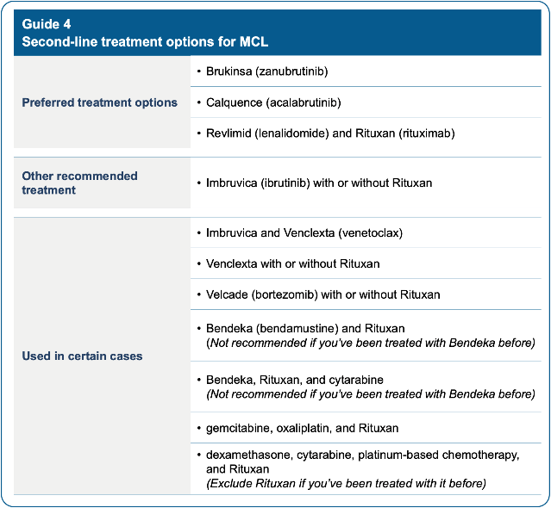
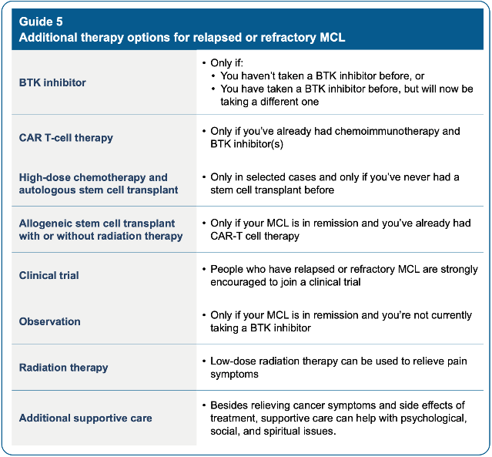
Current MCL guidelines
ESMO Clinical Practice Guidelines (2017)¹
NCCN (2023)²
ESMO, European Society for Medical Oncology; MCL, mantle cell lymphoma; NCCN, National Comprehensive Cancer Network.
1) Adapted from Dreyling M et al. Ann Oncol. 2017;28(suppl_4):iv62-iv71; 2) NCCN Patient Guidelines. 2023. Available at: https://www.nccn.org/patients/guidelines/content/PDF/Mantle-patient-guideline.pdf.

Slide 85
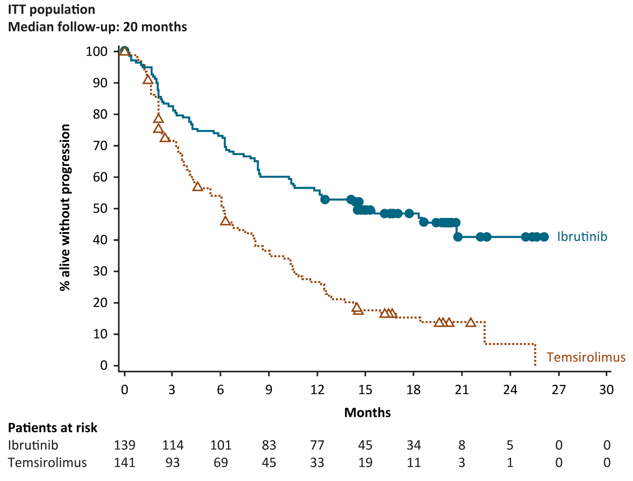
MCL3001 (RAY): ibrutinib vs temsirolimus in R/R MCL, Phase 3
Primary endpoint: IRC-assessed PFS
 | Ibrutinib | Temsirolimus
Median PFS (months) | 14.6 | 6.2
HR (investigator-assessed) | 0.43
95% CI | 0.32-0.58
Log-rank p value | <0.0001
ITT population
mFU: 20 months
At 2-year landmark: PFS rate 41% (Ibru) vs 7% (Tem)
CI, confidence interval; HR, hazard ratio; Ibru, ibrutinib; IRC, independent review committee; ITT, intention-to-treat; MCL, mantle cell lymphoma; mFU, median follow-up; PFS, progression-free survival; R/R, relapsed/refractory; Tem, temsirolimus.
Adapted from Dreyling M et al. Lancet. 2016;387(10020):770–778.

Slide 86
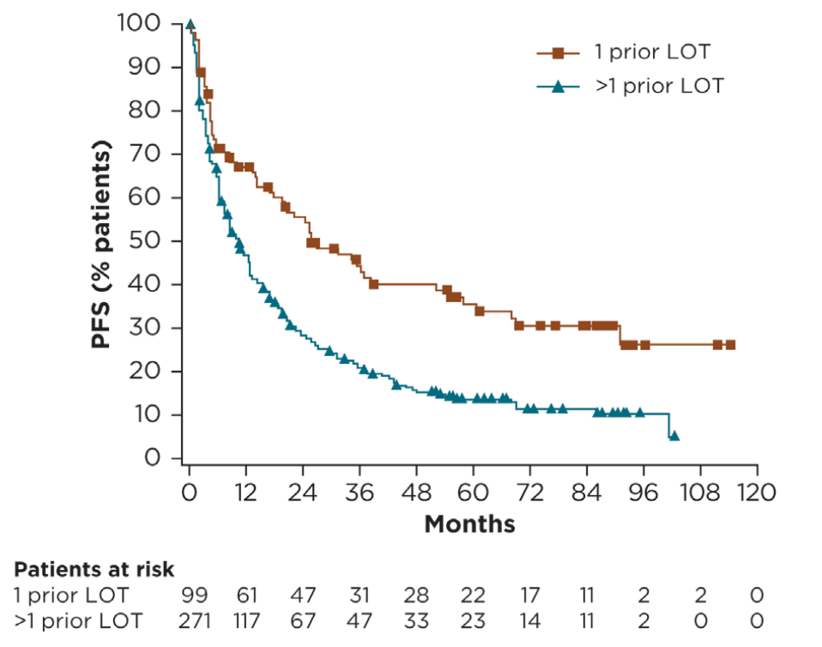
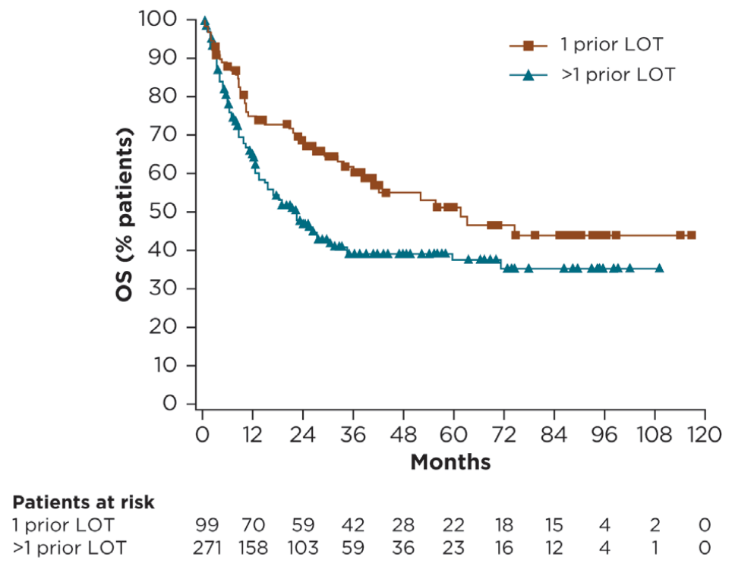
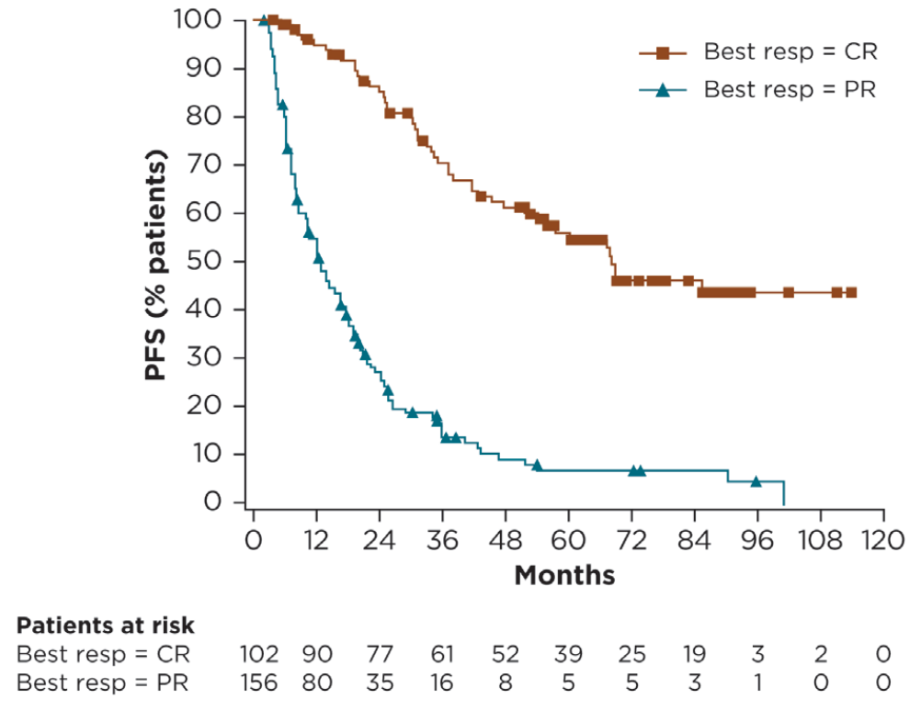
Pooled analysis of ibrutinib-treated patients in
RAY (Phase 3), PCYC-1104 (Phase 2), and SPARK (Phase 2) trials
PFS by best response (CR vs PR)
PFS and OS by prior LOT
In patients who achieved a CR (n=102):
mPFS and DOR = 68.5 and 66.4 months, respectively
mOS was NR with a 5-year OS rate of 83%
DOR in patients with CR was similar regardless of # of prior LOT
PFS and OS were better in ibrutinib-treated patients with 1 prior LOT (n=99) than in patients with >1 prior LOT (n=271):
mPFS was 25.4 months and median OS was 61.6 months
ORR 77.8%, with CR rate 37.4% and median DOR 35.6 mo.
CR, complete response; DOR: duration of response; LOT, line of treatment; (m)OS, (median) overall survival; (m)PFS, (median) progression-free survival; NR, not reached.
Adapted from Dreyling M et al. Hemasphere. 2022;6(5):e712.

Slide 87
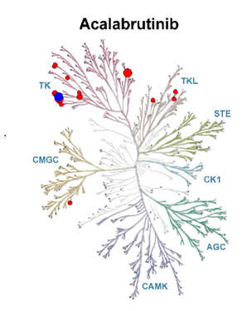
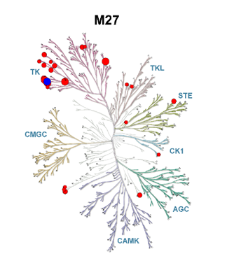
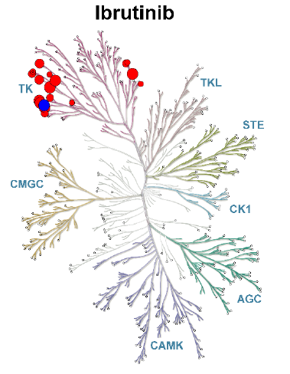
Kinase selectivity of zanubrutinib, ibrutinib, acalabrutinib, and acalabrutinib metabolite M27
Assayed by Reaction Biology Corp. at 100X of IC50 (against BTK) concentration with IC50 (BTK)s of 0.71±0.09, 0.32±0.09, 24±9.2, and 63±28 nM (n=3), for zanubrutinib, ibrutinib, acalabrutinib, and M27, respectively.
Please note, the use of different assays may result in different selectivity outcomes.
BTK, Bruton tyrosine kinase; IC₅₀, half-maximal inhibitory concentration.
Adapted from Shadman M et al. Lancet Haematol. 2023;10(1):e35-e45.

Slide 88
Study BGB-3111-206:
Zanubrutinib Monotherapy in Chinese Patients with Relapsed or Refractory Mantle Cell Lymphoma
Data Cut off: 8 September 2020
Song Y et al. Blood. 2022;139(21):3148–3158.
88

Slide 89
Zanubrutinib Multicenter, Open-Label, Single-Arm Trial^{1–4}
BGB-3111-206
Phase 2
Study Identifier: BGB-3111-206,
NCT03206970
Primary Endpoint: ORR† assessed by IRC using PET-based imaging per the Lugano criteria⁵
Key Secondary Endpoints: investigator-assessed ORR, PFS, DOR, time-to-response, safety
Key eligibility criteria
Treatment
Central pathologically confirmed MCL with measurable disease
Relapse or failure to achieve at least partial response to last regimen
≥1 but <5 prior lines of therapy
ECOG PS 0–2
An absolute neutrophil count of at least 1x10⁹/L and a platelet count of at least 75x10⁹/L*
Up to 3 years
Treatment until unacceptable toxicity, disease progression,
or end of study
Zanubrutinib 160 mg PO BID
(N=86)
†defined as either a PR or CR
*50x10⁹/L for patients with bone marrow involvement; independent of growth factor support or transfusion for at least 7 days.
BID=twice daily, CR=complete response, DOR=duration of response, ECOG PS=Eastern Cooperative Oncology Group performance status, IRC=independent review committee, MCL=mantle cell lymphoma, ORR=objective response rate, OS=overall survival, PET=positron emission tomography, PFS=progression-free survival, PO=per oral, PR=partial response, R/R=relapsed/refractory.
1. Song Y et al. Blood. 2022. 139 (21): 3148–3158.2. Song Y et al. Clin Cancer Res. 2020;26(16):4216–4224. 3. Song Y et al. ICML 2019. 4. ClinicalTrials.gov. https://www.clinicaltrials.gov/ct2/show/NCT03206970. Accessed January 29, 2021. 5. Cheson BD et al. J Clin Oncol. 2014;32(27):3059–3067.
89

Slide 90
Exposure and Patient Disposition
BGB-3111-206
Median follow-up (range): 35.3 months (0.3–41.6)
Median duration of exposure (range): 27.6 months (0.2-41.6)
Enrolled/Safety
Population
N=86
Off-Treatment
n=47 (54.7%)
n=37 PD (43.0%)
n=8 AE (9.3%)
n=1 physician’s discretion (1.2%)
n=1 withdrawal by patient after achieving CR (1.2%)
On-Study Treatment
n=39 (45.3%)
Data cutoff 8 September 2020.
AE=adverse event, CR=complete response, PD=progressive disease.
Song Y et al. Blood. 2022. 139 (21): 3148–3158.This study is registered at ClinicalTrials.gov (NCT03206970).
90

Slide 91
Patient and Disease Characteristics
BGB-3111-206
Characteristic | Total (N=86)
Age
Median (range), years | 61 (34–75)
≥65 years, n (%) | 22 (25.6%)
Race, n (%)
Chinese | 86 (100.0%)
Sex, n (%)
Male | 67 (77.9%)
Female | 19 (22.1%)
ECOG PS, n (%)
0/1 | 82 (95.3%)
2 | 4 (4.7%)
Extranodal disease, n (%) | 61 (70.9%)
Bone marrow involvement | 39 (45.3%)
Gastrointestinal involvement | 15 (17.4%)
Refractory diseaseª | 45 (52.3%)
TP53-mutated (N=54)^{b} | 15 (27.8%)
Bulky disease, n (%)
>5 cm tumor mass | 37 (43.0%)
Characteristic | Total (N=86)
Blastoid variant of MCL, n (%) | 12 (14.0%)
Patients with prior lines of therapy, n (%) | 86 (100.0%)
Median (range) number of prior therapies | 2 (1–4)
≥3 prior therapies, n (%) | 29 (33.7%)
Prior regimens,^{c} n (%)
Patients with ≥1 rituximab-containing regimen | 64 (74.4%)
R-CHOP, R-CHOP-like | 46 (53.5%)
CHOP, CHOP-like | 31 (36.0%)
High-dose cytarabine-containing regimen^{d} | 33 (38.4%)
(R) hyper-CVAD (A)/EPOCH | 23 (26.7%)
Lenalidomide | 12 (14.0%)
Bortezomib | 7 (8.1%)
Stem cell transplant | 3 (3.5%)
MIPI-b, n (%)^{e}
Low-risk | 12 (14.0%)
Intermediate-risk | 39 (45.3%)
High-risk | 33 (38.4%)
Missing | 2 (2.3%)
Data cutoff 8 September 2020. Note: Percentages may not add up to 100% because of rounding.
ªRefractory disease was defined as the lack of at least a partial response to the last therapy before study entry, as assessed by the investigator. ^{b}54 patients had baseline sequencing. For the remaining patients, 21 did not provide consent, 9 lacked adequate tumor tissue, and for 2, the assay failed at the library preparation step ^{c}Categories are not mutually exclusive as patients may be included under multiple regimens. ^{d}High-dose cytarabine-containing regimens included dexamethasone, cytarabine and cisplatin (DHAP; etoposide, methylprednisolone, cytarabine, cisplatin (ESHAP); methotrexate and cytarabine (hyperCVAD B); cyclophosphamide, etoposide, cytarabine, methylprednisolone, vincristine, nedaplatin (CDEADP) ^{e}MIPI-b score was derived with the use of four baseline clinical prognostic factors (age, ECOG performance status, lactate dehydrogenase level, and white blood cell count) plus percent Ki-67 expression in tumor cells, and its range depends on the range of these characteristics.44,45 The index classifies patients as having low-, intermediate-, or high-risk disease, as defined by scores of <5.7, ≥5.7 to <6.5 and ≥6.5, respectively. CHOP=cyclophosphamide, doxorubicin, vincristine, and prednisone, ECOG PS=Eastern Cooperative Oncology Group performance status, EPOCH=etoposide, prednisone, vincristine, cyclophosphamide, and doxorubicin, hyper-CVAD=cyclophosphamide, vincristine, doxorubicin, and dexamethasone, MCL=mantle cell lymphoma, MIPI-b=Biologic Mantle Cell Lymphoma International Prognostic Index, R=rituximab. TP53=tumor protein 53 gene.
Song Y et al. Blood. 2022. 139 (21): 3148–3158.This study is registered at ClinicalTrials.gov (NCT03206970).
91

Slide 92
Efficacy: Best Overall Response
BGB-3111-206
IRC-assessed efficacy variable¹ (15 February 2019 data cutoff) | N=86
Median time to response, months (range) | 2.7 (2.5–16.6)
Median duration of response, months (95% CI) | 19.5 (0.9–19.5)
Event-at risk free rate at 12 months, % (95% CI) | 78.3 (67.0-86.0)
Discontinued prior to first assessment
No on-treatment
response assessments**
Progressive disease
Stable disease
Partial response
Complete response
ORR*: 84.0%
CI 74.0-91.0
ORR*: 83.7%
CI 74.2-90.8
Investigator-assessed efficacy variable² (8 September 2020 data cutoff) | N=86
Median time to response, months (range) | 2.7 (2.5–3.0)
Median time to CR, months (range) | 2.8 (2.5-16.7)
Median duration of response, months (95% CI) | NE (24.9-NE)
Event-at risk free rate at 30 months, % (95% CI) | 57.3 (44.9-67.9)
¹
²
*ORR calculated as complete responses + partial responses. **Includes one patient with no evidence of disease at baseline
BID=twice daily, BOR=best overall response, CI=confidence interval, CR=complete response, IRC=independent review committee, PO=orally, ORR=overall response rate.
1. Song Y et al. Clin Cancer Res. 2020;26(16):4216–4224 2. Song Y et al. Blood. 2022. 139 (21): 3148–3158.
92

Slide 93
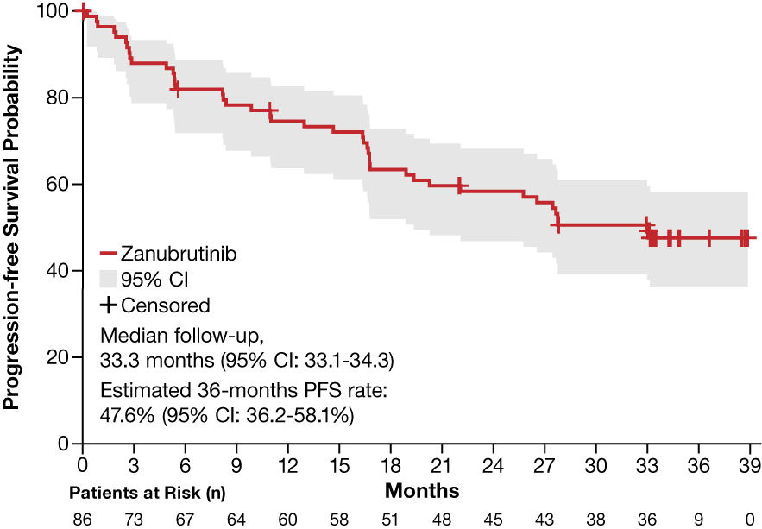

Progression-Free and Overall Survival by Investigator
BGB-3111-206
Median PFS was 33.0 months (95% CI: 19.4-NE)¹
  15 February 2019 data cutoff: Median PFS was 22.1 months (95% CI: 17.4-NE)²
Median OS was not reached¹
Data cutoff 8 September 2020.
CI=confidence interval. NE=Not estimable, OS=overall survival, PFS=progression-free survival
1. Song Y et al. Blood. 2022. 139 (21): 3148–3158.2. Song Y et al. Clin Cancer Res. 2020;26(16):4216–4224 This study is registered at ClinicalTrials.gov (NCT03206970).
93

Slide 94

PFS and OS by Investigator-Assessed Best Response
BGB-3111-206
Median PFS was not reached in patients achieving CR (95% CI: 27.8-NE), 16.6 months (95% CI: 5.3-NE) in patients achieving PR, and 2.6 months (95% CI: 0.8-2.9) in patients who were non-responders (SD/PD)
  Data cutoff 8 September 2020.
CI=confidence interval, CR=complete response, NE=not evaluable, OS=overall survival, PD=progressive disease, PFS=progression-free survival, PR=partial response, SD=stable disease
Song Y et al. Blood. 2022. 139 (21): 3148–3158.This study is registered at ClinicalTrials.gov (NCT03206970).
94

Slide 95

DoR, PFS, and OS by MCL Histology
BGB-3111-206
Duration of Response
Progression-Free Survival
Overall Survival
Median DoR and PFS were 30.2 months and 25.0 months in patients with blastoid histology – similar to patients with classic histology (median DOR, 30.6 months; PFS, 27.8 months)
Overall survival was lower in patients with blastoid histology (50.0% at 36 months) compared to classic histology patients (77.5% at 36 months)
Data cutoff 8 September 2020.
CI=confidence interval, DoR=duration of response, MCL=mantle cell lymphoma, OS=overall survival, PFS=progression-free survival
Song Y et al. Blood. 2022. 139 (21): 3148–3158.This study is registered at ClinicalTrials.gov (NCT03206970).
95

Slide 96

DoR, PFS, and OS by TP53 mutation status
BGB-3111-206
Duration of Response
Progression-Free Survival
Overall Survival
In patients with mutated and wild-type TP53 respectively, median PFS was 14.7 months (95% CI, 2.9–NE) and not reached (95% CI, 19.4–NE), median OS was 37.1 months (95% CI, 4.9–NE) and not reached (95% CI, NE-NE)
Overall survival was higher in patients with wild-type TP53 (85.8% at 36 months) than in patients with mutated TP53 (57.1% at 36 months)
Data cutoff 8 September 2020.
CI=confidence interval, DoR=duration of response, M=mutated, MCL=mantle cell lymphoma, OS=overall survival, PFS=progression-free survival, TP53=tumor protein 53 gene, WT=wild-type
Song Y et al. Blood. 2022. 139 (21): 3148–3158.This study is registered at ClinicalTrials.gov (NCT03206970).
96

Slide 97

Adverse Events in ≥10% of Patients Regardless of Causality
BGB-3111-206
The most common TEAEs, regardless of causality, in ≥20% of patients (most were grade 1/2 events) were:
Neutrophil count decreased (46.5%)
URTI (38.4%)
Rash (36.0%)
WBC count decreased (33.7%)
Platelet count decreased (32.6%);
Grade ≥3 TEAEs were reported in 50.0% of patients and were most commonly (≥5%):
Neutrophil count decreased (18.6%)
Pneumonia (12.8%)
Platelet count decreased (7.0%),
WBCl count decreased (7.0%)
Anemia (5.8%)
Data cutoff 8 September 2020.
TEAE=treatment emergent adverse event
Song Y et al. Blood. 2022. 139 (21): 3148–3158.This study is registered at ClinicalTrials.gov (NCT03206970).
97

Slide 98
Summary of trial BGB-3111-206
Zanubrutinib demonstrated high activity in patients with R/R MCL
  The ORR was 83.7% (95% CI: 74.2-90.8%) with 77.9% CR
  Most patients achieved a response by the first efficacy assessment; median time to response was 2.73 months
  PFS was 33.0 months (95% CI: 19.4-NE) and median OS was not reached
  Outcomes for patients with TP53 mutation, though worse than TP53 wild-type patients, appear to be substantially better than those previously reported for BTK inhibitor therapy
Zanubrutinib was generally well tolerated in patients with R/R MCL
  No new safety concerns have been reported with 35.3 months of follow-up
  Grade ≥3 BTK inhibitor-associated toxicities were uncommon
  No cases of atrial fibrillation/flutter, grade ≥3 cardiac AEs, second primary malignancies, or tumor lysis syndrome were reported throughout this study
Data cutoff 8 September 2020.
AE=adverse event; BTK=Bruton’s tyrosine kinase, BTK=Bruton’s tyrosine kinase, CR=complete response, DOR=duration of response, IRC=independent review committee, MCL=mantle cell lymphoma, NDA=New Drug Application, NMPA=National Medical Products Administration, ORR=objective response rate,OS=overall survival; PFS=progression-free survival, R/R=relapsed/refractory.
Song Y et al. Blood. 2022. 139 (21): 3148–3158.
This study is registered at ClinicalTrials.gov (NCT03206970).
98

Slide 99

ª Increased TLS risk was defined as at least 1 lesion >10 cm, or at least 1 lesion >5 cm with circulating lymphocytes >25,000 cells/mm³, and/or creatinine clearance <60 mL/min. ^{b} For hierarchical testing per US FDA censoring, TTNT was tested after OS.
CR, complete response; ECOG PS, Eastern Cooperative Oncology Group performance status; PD, progressive disease; PFS, progression-free survival; ORR, overall response rate; OS, overall survival; TLS, tumor lysis syndrome; TTNT, time to next treatment.
Wang M et al. Blood. 2023;142(Supplement 2):LBA-2.
99

Slide 100

BM, bone marrow; CLL, chronic lymphocytic leukemia; ECOG PS, Eastern Cooperative Oncology Group performance status; MCL, mantle cell lymphoma; MIPI, Mantle Cell Lymphoma International Prognostic Index; TP53, tumor protein p53.
Wang M et al. Blood. 2023;142(Supplement 2):LBA-2.
100

Slide 101

ª P values were determined by stratified log-rank test (stratification factors: prior lines of therapy [1-2 vs ≥3] and TLS risk category [low vs increased risk]). ^{b} Censoring at last non-PD assessment for patients without PD or death. ^{c} Patients were censored at last non-PD assessment before start of subsequent anticancer therapy or missing ≥2 consecutive visits prior to a PFS event, whichever occurred first.
CI, confidence interval; HR, hazard ratio; Ibr, ibrutinib; IRC, independent review committee; Pbo, placebo; PFS, progression-free survival; Ven, venetoclax.
Wang M et al. Blood. 2023;142(Supplement 2):LBA-2.
101

Slide 102

ª P values were determined by stratified log-rank test (stratification factors: prior lines of therapy [1-2 vs ≥3] and TLS risk category [low vs increased risk]).
CI, confidence interval; HR, hazard ratio; Ibr, ibrutinib; OS, overall survival; Pbo, placebo; Ven, venetoclax.
Wang M et al. Blood. 2023;142(Supplement 2):LBA-2.
102

Slide 103
BTKi in relapsed MCL – Summary*
BTKi have defined standard of care in R/R MCL¹
More beneficial in earlier lines of treatment¹
No clear “best” BTKi in terms of efficacy²
Difference between them: side-effect profile²
  Ibrutinib - AF/cardiovascular side-effects³
  Zanubrutinib appears to have less cardiotoxicity
Comparing ORR and DOR across trials is difficult due to heterogeneous patient populations²
Real-world data suggest patients with early POD24 may have short second PFS on 2L BTKi⁴
Addition of BCL2 inhibitor venetoclax to ibrutinib prolongs PFS in 2L⁵
2L, second-line; AF, atrial fibrillation; BCL2, B-cell lymphoma-2; BTKi, Bruton’s tyrosine kinase inhibitor; DOR, duration of response; MCL, mantle cell lymphoma; ORR, overall response rate; POD24, progression of disease within 24 months of 1L therapy; PFS2, second progression-free survival; R/R, relapsed/refractory.
*For further information on dose reductions and minimising risk of cardiac events with ibrutinib, please see the November 2022 DHPC letter, available at https://www.medicines.org.uk/emc/dhpc/2566/Document (Accessed March 2024)
1) Dreyling M et al. Hemasphere. 2022;6(5):e712; 2) Dr Lewis, personal communication; 3) Ibrutinib Summary of Product Characteristics, available at https://www.medicines.org.uk/emc/product/10025/smpc; 4) Villa D et al. Blood Adv. 2023;7(16):4576–4585; 5) Wang M et al. Blood. 2023;142(Supplement 2):LBA-2.

Slide 104
Can we improve on 1L therapy using BTKi?
BTKi as 1L?
Several clinical trials are investigating 1L BTKi:
  With chemo
  Vs chemo
  In combination (e.g., BCL2 + anti-CD20)
Three major randomized trials have reported so far (SHINE, ECHO, TRIANGLE)^{1–3}
1L, first-line; BCL2, B-cell lymphoma-2; BTKi, Bruton’s tyrosine kinase inhibitor.
1) Wang M et al. N Engl J Med. 2022;386(26):2482-2494; 2) Wang M et al. EHA 2024; Abstract LB3439; 3) Dreyling M et al. Blood. 2022;140 (Supplement 1):1–3.

Slide 105
SHINE: a randomized, double-blind, Phase 3 study of
BR + ibrutinib vs BR
Patients
Previously untreated MCL
≥ 65 years of age
Stage II-IV disease
No planned stem cell transplant
Stratification factor
Simplified MIPI score
(low vs intermediate vs high)
BR induction for 6 cycles
if CR or PR
Rituximab maintenance
every 8 weeks for 12 cycles
N = 523
Ibrutinib 560 mg (4 capsules daily) until PD or unacceptable toxicity
R
1:1
BR induction for 6 cycles
if CR or PR
Rituximab maintenance
every 8 weeks for 12 cycles
Placebo (4 capsules daily) until PD or unacceptable toxicity
Primary end point: PFS (investigator-assessed) in the ITT population
Key secondary end points: response rate, time to next treatment, overall survival, safety
Enrolled between May 2013 and November 2014 at 183 sites
Induction: Bendamustine 90 mg/m2 Days 1 and 2, Rituximab 375 mg/m2 Day 1, Q4W. A cycle is defined as 28 days.
BR, bendamustine+rituximab; CR, complete response; ITT, intent-to-treat; MIPI, Mantle Cell Lymphoma International Prognostic Index; PD, progressive disease; PFS, progression-free survival;
PR, partial response; R, randomization.
Wang M et al. N Engl J Med. 2022;386(26):2482-2494.
105

Slide 106
SHINE: Primary end point of improved PFS met
Ibrutinib + BR and R maintenance showed 25% reduction in risk of PD or death¹
Significant improvement in median PFS by 2.3 years (6.7 vs 4.4 years)¹
100
90
 | Ibrutinib + BR (N = 261) | Placebo + BR (N = 262)
Median PFS, months (95% CI) | 80.6 (61.9-NE) | 52.9 (43.7-71.0)
Stratified HR (95% CI) | 0.75 (0.59-0.96)
p value | 0.011*²
80
70
Ibru+BR
60
PFS (%)
50
40
Pbo+BR
30
20
*Significance boundary for superiority was p <0.023.
10
Ibrutinib + BR
0
Placebo + BR
0
6
12
18
24
30
36
42
48
54
60
66
72
78
84
90
96
Months
Patients at Risk
Ibrutinib + BR
261
228
207
191
182
167
152
139
130
120
115
106
95
78
39
11
0
Placebo + BR
262
226
199
177
166
158
148
135
119
109
103
98
90
78
41
11
0
BR, bendamustine+rituximab; CI, confidence interval; HR, hazard ratio; Ibru, ibrutinib; NE, not evaluable; Pbo, placebo; PD, progressive disease; PFS, progression-free survival; R. rituximab.
1) Adapted from Wang M et al. N Engl J Med. 2022;386(26):2482-2494; 2) Wang M et al. J Clin Oncol. 2022;40:17_suppl, LBA7502-LBA7502.
106

Slide 107
SHINE: No OS benefit for addition of ibrutinib to BR
 | Ibrutinib + BR (N = 261) | Placebo + BR (N = 262)
Median OS, months | NR | NR
HR (95% CI) | 1.07 (0.81-1.40)
Cause of death | Ibrutinib + BR (N = 261) | Placebo + BR (N = 262)
Death due to PD and TEAE | 58 (22.2%) | 70 (26.7%)
Death due to PD | 30 (11.5%) | 54 (20.6%)
Death due to TEAEs | 28 (10.7%) | 16 (6.1%)
Death during post-treatment follow-up period excluding PD | 46 (17.6%) | 37 (14.1%)
Total deaths | 104 (39.8%) | 107 (40.8%)
100
90
80
70
Pbo+BR, 57%
60
Patients Alive (%)
50
Ibru+BR, 55%
40
30
20
10
Ibrutinib + BR
0
Placebo + BR
  Death due to COVID-19 occurred in 3 patients in the ibrutinib arm during the TEAE period and in 2 patients in the placebo arm after the TEAE period
  The most common Grade 5 TEAE was infections in the ibrutinib and placebo arms: 9 versus 5 patients. Grade 5 TEAE of cardiac disorders occurred in 3 versus 5 patients, respectively
  Exploratory analysis of cause-specific survival including only deaths due to PD or TEAEs showed an HR of 0.88
0
6
12
18
24
30
36
42
48
54
60
66
72
78
84
90
96
Months
Patients at Risk
Ibrutinib + BR
261
239
221
208
197
187
171
163
158
152
145
138
128
118
70
25
0
Placebo + BR
262
244
223
212
203
197
188
177
171
165
159
154
147
137
90
31
2
BR, bendamustine+rituximab; CI, confidence interval; HR, hazard ratio; Ibru, ibrutinib; NR, not reached; OS, overall survival; Pbo, placebo; PD, progressive disease; TEAE, treatment-emergent adverse event.
Adapted from Wang M et al. N Engl J Med. 2022;386(26):2482-2494.
107

Slide 108
ECHO: BR + acalabrutinib vs BR
ECHO: multicenter, double-blind, placebo-controlled, Phase 3 trial
Primary endpoint:
PFS (Independent Review Committee)
Key secondary endpoints:
ORR (Independent Review Committee)
OS
Safety
Untreated MCL (N=598)
Age ≥65 years
ECOG PS ≤2
Stratification
sMIPI score: Low vs intermediate vs high
Geographic region: North America vs Western Europe vs other
RANDOMIZE
Bendamustineª
Rituximab^{b}
x 6 cycles
if ≥PR
Maintenance Rituximab
(every 2 cycles x 2 years)
Acalabrutinib 100 mg BID, PO until PD or toxicity
Crossover to acalabrutinib after PD was permitted
Bendamustineª
Rituximab^{b}
x 6 cycles
if ≥PR
Maintenance Rituximab
(every 2 cycles x 2 years)
Placebo BID, PO until PD or toxicity
Enrollment: Apr 2017–Mar 2023
Sites: 195 globally
1:1
1 cycle = 28 days
ª Bendamustine 90 mg/m² on Days 1 and 2. ^{b} Rituximab 375 mg/m² on Day 1.
BID, twice daily; ECOG PS, Eastern Cooperative Oncology Group performance status; MCL, mantle cell lymphoma; sMIPI, simplified Mantle Cell Lymphoma International Prognostic Index; ORR, overall response rate; OS, overall survival; PD, progressive disease; PFS, progression-free survival; PO, orally; PR, partial response.
Wang M et al. EHA 2024; Abstract LB3439.
108
Notes:
^d8220c00004-csp-v4: pg 33A, 34A, 36ABC, 39AB, 86A, 87AB, 89A
^Jingyang QC of draft EHA 2024_ECHO Abstract 5-6-2024: pg 3 (yellow highlight)

Slide 109
ECHO: Demographics and baseline characteristics
 | Acalabrutinib + BR (n=299) | Placebo + BR (n=299)
Age, median (range), y | 71 (65–85) | 71 (65–86)
≥75 y, n (%) | 84 (28.1) | 77 (25.8)
Male, n (%) | 214 (71.6) | 209 (69.9)
ECOG PS, n (%)
1 | 129 (43.1) | 132 (44.1)
2 | 12 (4.0) | 23 (7.7)
Tumor bulk ≥5 cm, n (%) | 112 (37.5) | 113 (37.8)
Blastoid/pleomorphic histology, n (%) | 41 (13.7) | 38 (12.7)
Simplified MIPI score, n (%)
Low risk | 99 (33.1) | 101 (33.8)
Intermediate risk | 128 (42.8) | 125 (41.8)
High risk | 72 (24.1) | 73 (24.4)
Extranodal disease, n (%) | 264 (88.3) | 277 (92.6)
TP53 status, n (%)ª
Mutated | 22 (7.4) | 29 (9.7)
Unmutated | 97 (32.4) | 83 (27.8)
Ki-67, n (%)
<30% | 133 (44.5) | 126 (42.1)
≥30% | 139 (46.5) | 147 (49.2)
ª All other patients in the acalabrutinib (n=180) and placebo (n=187) groups had unknown TP53 mutation status.
BR, bendamustine + rituximab; ECOG PS, Eastern Cooperative Oncology Group performance status; MIPI, Mantle Cell Lymphoma International Prognostic Index.
Adapted from Wang M et al. EHA 2024; Abstract LB3439.
109
Notes:
^ly308_combined_pdf_HLR 1: pg 6BC, 8A, 9A, 10A, 11A, 12BC
^(Updated) TP53 mutation: t_basechar_all: pg 5 (yellow highlight)
^Ki-67: t_basechar_all: pg 3 (yellow highlight)

Slide 110
ECHO: Adverse events of interest
 | Acalabrutinib + BR (n=297) |  | Placebo + BR (n=297)
 | Any grade | Grade ≥3 | Any grade | Grade ≥3
Event, n (%)
Atrial fibrillation | 18 (6.1) | 11 (3.7) | 13 (4.4) | 5 (1.7)
Hypertension | 36 (12.1) | 16 (5.4) | 47 (15.8) | 25 (8.4)
Major bleedingª | 7 (2.4) | 6 (2.0) | 16 (5.4) | 10 (3.4)
Infections^{b} | 232 (78.1) | 122 (41.1) | 211 (71.0) | 101 (34.0)
Second primary malignancies (excluding non-melanoma skin)^{b} | 29 (9.8) | 16 (5.4) | 32 (10.8) | 20 (6.7)
Median treatment exposure (range), months | 29 (0.1, 80.1) |  | 25 (0.03, 76.4)
ªGrouping of preferred terms; defined as a hemorrhagic event that is serious, or grade ≥3 in severity, or that is a CNS hemorrhage (any severity grade). ^{b}Grouping of preferred terms.
BR, bendamustine + rituximab; CNS, central nervous system.
Adapted from Wang M et al. EHA 2024; Abstract LB3439.
110
Notes:
^Atrial fibrillation: ly308_combined_pdf_HLR 1: 31 (yellow highlight)
^Hypertension: ly308_combined_pdf_HLR 1: 76 (yellow highlight)
^Major bleeding, infections, SPM: t_eci_mn: pg 1 (yellow highlight)
^Median exposure: t_exposure_acp
^Footnote a: d8220c00004-sap-ed-5: pg 69A
^Footnote b: d8220c00004-sap-ed-5: pg 68A

Slide 111
PFS with and without COVID-19 deaths:
Prespecified sensitivity analysis
Full analysis population
COVID-19 deaths censored
100
80
60
40
20
0
100
80
60
40
20
0
Acalabrutinib + BR
Placebo + BR
Acalabrutinib + BR
Placebo + BR
Progression-Free Survival, %
Progression-Free Survival, %
 | ABR (n=299) | PBR (n=299)
PFS events, n (%) | 110 (36.8) | 137 (45.8)
PD | 57 (19.1) | 99 (33.1)
Median PFS, months (95% CI) | 66.4 (55.1, NE) | 49.6 (36.0, 64.1)
Stratified HR (95% CI), log-rank P-value | 0.73 (0.57, 0.94), P=0.0160
 | ABR (n=299) | PBR (n=299)
PFS events, n (%) | 83 (27.8) | 117 (39.1)
PD | 57 (19.1) | 99 (33.1)
Median PFS, months (95% CI) | NE (66.4, NE) | 61.6 (49.6, 68.9)
Stratified HR (95% CI), log-rank P-value | 0.64 (0.48, 0.84), P=0.0017
0 | 6 | 12 | 18 | 24 | 30 | 36 | 42 | 48 | 54 | 60 | 66 | 72 | 78
 |  |  |  |  |  | Months
299 | 258 | 232 | 205 | 182 | 156 | 136 | 122 | 98 | 73 | 53 | 34 | 2 | 0
299 | 243 | 204 | 181 | 159 | 142 | 118 | 102 | 84 | 63 | 44 | 25 | 4 | 0
0 | 6 | 12 | 18 | 24 | 30 | 36 | 42 | 48 | 54 | 60 | 66 | 72 | 78
 |  |  |  |  |  | Months
299 | 258 | 232 | 205 | 182 | 156 | 136 | 122 | 98 | 73 | 53 | 34 | 2 | 0
299 | 243 | 204 | 181 | 159 | 142 | 118 | 102 | 84 | 63 | 44 | 25 | 4 | 0
Number at risk
Acala + BR
Placebo + BR
Number at risk
Acala + BR
Placebo + BR
36% risk reduction when censoring COVID-19 deaths
ABR, acalabrutinib + bendamustine + rituximab; BR, bendamustine + rituximab; CI, confidence interval; COVID-19, coronavirus disease 2019; HR, hazard ratio; NE, not estimable; PBR, placebo + bendamustine + rituximab; PFS, progression-free survival.
Adapted from Wang M et al. EHA 2024; Abstract LB3439.
111
Notes:
Left figure:
^TABLE: ly308_combined_pdf_HLR 1: pg 14AB, 15A
^FIGURE: ly308_combined_pdf_HLR 1: pg 18
Right figure:
^Table: t_km_pfsirc_covid: pg 1-2 (yellow highlight)
^Figure: f_km_pfsirc_covid
^Bullet: 1 – 0.64 (HR) = 36% (COVID-19 death reduction in risk)

Slide 112
OS with and without COVID-19 deaths:
Prespecified sensitivity analysis
Full analysis population (including crossover)
COVID-19 deaths censored
100
80
60
40
20
0
100
80
60
40
20
0
Acalabrutinib + BR
Placebo + BR
Acalabrutinib + BR
Placebo + BR
Overall Survival, %
Overall Survival, %
 | ABR (n=299) | PBR (n=299)
OS events, n (%) | 97 (32.4) | 106 (35.5)
Median OS, months (95% CI) | NE (72.1, NE) | NE (73.8, NE)
Stratified HR (95% CI), log-rank P-value | 0.86 (0.65, 1.13), P=0.2743
 | ABR (n=299) | PBR (n=299)
OS events, n (%) | 64 (21.4) | 80 (26.8)
Median OS, months (95% CI) | NE (NE, NE) | NE (73.8, NE)
Stratified HR (95% CI), log-rank P-value | 0.75 (0.53, 1.04), P=0.0797
0 | 6 | 12 | 18 | 24 | 30 | 36 | 42 | 48 | 54 | 60 | 66 | 72 | 78 | 84
 |  |  |  |  |  | Months
299 | 280 | 259 | 243 | 230 | 207 | 181 | 163 | 146 | 110 | 86 | 58 | 25 | 3 | 0
299 | 268 | 247 | 229 | 215 | 193 | 175 | 157 | 141 | 108 | 78 | 51 | 21 | 3 | 0
0 | 6 | 12 | 18 | 24 | 30 | 36 | 42 | 48 | 54 | 60 | 66 | 72 | 78 | 84
 |  |  |  |  |  | Months
299 | 280 | 259 | 243 | 230 | 207 | 181 | 163 | 146 | 110 | 86 | 58 | 25 | 3 | 0
299 | 268 | 247 | 229 | 215 | 193 | 175 | 157 | 141 | 108 | 78 | 51 | 21 | 3 | 0
Number at risk
Acala + BR
Placebo + BR
Number at risk
Acala + BR
Placebo + BR
ABR, acalabrutinib + bendamustine + rituximab; BR, bendamustine + rituximab; CI, confidence interval; COVID-19, coronavirus disease 2019; HR, hazard ratio; NE, not estimable; OS, overall survival;
PBR, placebo + bendamustine + rituximab.
Adapted from Wang M et al. EHA 2024; Abstract LB3439.
112
Notes:
Left figure:
TABLE: ly308_combined_pdf_HLR 1: pg 22ABC
FIGURE: ly308_combined_pdf_HLR 1: 26
Right figure:
^Table: t_km_os_cov_cnsr: pg 1 (yellow highlight)
^Figure: f_km_os_covcns

Slide 113

TRIANGLE: Ibrutinib + CIT +/- ASCT vs CIT +/- ASCT in TN MCL
Group A (control)
Group A+I (experimental)
Group I (experimental)
ACST, autologous stem cell transplantation; CIT, chemoimmunotherapy; MCL, mantle cell lymphoma; R-CHOP, rituximab, cyclophosphamide, doxorubicin hydrochloride (hydroxydaunorubicin), vincristine sulfate (Oncovin), and prednisone; R-DHAP, rituximab, dexamethasone, cytarabine, cisplatin; TN, treatment naïve; yrs, years.
Dreyling M et al. Blood. 2022;140 (Supplement 1):1–3.
113

Slide 114

TRIANGLE: FFS improved by addition of Ibru to CIT + ASCT
Primary endpoint FFS (similar to PFS but includes SD)
Significant improvement in FFS for Group A+I vs Group A (HR 0.52)
Prespecified question: Is Group A superior to Group I?
Answer: No (HR 1.77)
Group I vs Group A+I ongoing
114
ACST, autologous stem cell transplantation; CI, confidence interval; CIT, chemoimmunotherapy; FFS, failure-free survival; HR, hazard ratio; Ibru, ibrutinib; PFS, progression-free survival; SD, stable disease.
Dreyling M et al. Blood. 2022;140 (Supplement 1):1–3.

Slide 115

TRIANGLE: OS not yet assessed for statistical significance
3-year OS:
Group I: 92%
Group A+I: 91%
Group A: 86%
115
OS, overall survival.
Dreyling M et al. Blood. 2022;140 (Supplement 1):1–3.

Slide 116

TRIANGLE: AEs during maintenance – more Grade 3+ with ASCT+I
ACST, autologous stem cell transplantation; AE, adverse event; I, ibrutinib; R-CHOP, rituximab, cyclophosphamide, doxorubicin hydrochloride (hydroxydaunorubicin), vincristine sulfate (Oncovin), and prednisone; R-DHAP, rituximab, dexamethasone, cytarabine, cisplatin.
Dreyling M et al. Blood. 2022;140 (Supplement 1):1–3.
116

Slide 117
TRIANGLE: “Transplant eligible” – conclusions
TRIANGLE sets a new standard of care in “ASCT-eligible” previously untreated MCL patients¹
ASCT in CR1: Adds toxicity, no PFS benefit if ibrutinib given with 1st line treatment ¹
Unanswered questions:
  Will OS benefit persist and reach statistical significance?
  Can we retreat with BTKi at progression?
  Or go straight to CAR-T?
Obinutuzumab better than rituximab? But retrospective study…. ²
ACST, autologous stem cell transplantation; BTKi, Bruton’s tyrosine kinase inhibitor; CAR-T, chimeric antigen receptor T cells; CR1, first complete remission; MCL, mantle cell lymphoma; OS, overall survival; PFS, progression-free survival.
1) Dreyling M et al. Blood. 2022;140 (Supplement 1):1–3; 2) Sarkozy C et al. Blood. 2024;144(3):262-271.
117

Slide 118


TRIANGLE approach now reflected in MCL treatment guidelines
NCCN interim guidance (2023)¹
BSH guideline (2023)²
ACST, autologous stem cell transplantation; BSH, British Society for Haematology; MCL, mantle cell lymphoma; NCCN, National Comprehensive Cancer Network; R-CHOP, rituximab, cyclophosphamide, doxorubicin hydrochloride (hydroxydaunorubicin), vincristine sulfate (Oncovin), and prednisone; R-DHAP, rituximab, dexamethasone, cytarabine, cisplatin; TP53, tumor protein p53.
1) NCCN NCL physician interim guideline 2023 (not yet published); 2) Eyre TA et al. Br J Haematol. 2024;204(1):108-126.
118

Slide 119

First-line acalabrutinib-rituximab in elderly MCL (Phase 2)
Time to event outcomes – median follow-up 17 months
  mPFS and mOS were NR (2-year rates 92% and 96%, respectively)
  3 patients had PD after 2, 3, 16 months after treatment
  One patient had SD, BM cleared but developed RASopathy / CMML
  Overall, 3 patients died: 1 with primary progression, 1 unknown in CR and 1 off-study RAS / CMML
BM, bone marrow; CMML, chronic myelomonocytic leukemia; CR, complete response; MCL, mantle cell lymphoma; mOS, median overall survival; mPFS, median progression-free survival; NR, not reached; PD, progressive disease; SD, stable disease.
Jain P et al. Blood. 2023;142:3036–3038.
119

Slide 120
Ongoing BTKi clinical trials in TN MCL
Trial | Identifier | Phase | Regimen | Population | Status
ENRICH | Eudract 2015-000832-13 | 2 | ibrutinib + R vs CT + R | older patients | Fully recruited, n=397, submitted to ASH2024
MANGROVE | NCT04002297 | 3 | zanubrutinib + R vs BR | not SCT-eligible | Active
OASIS II | NCT04802590 | 2 | ibrutinib + R vs ibrutinib + R + Ven | 18-80 years | Recruiting
TrAVeRse | NCT05951959 | 2 | acalabrutinib + R + Ven | ≥18 years, PS 0-2 | Active
BOVen | NCT03824483 | 2 | zanubrutinib + Obi + Ven | ≥18 years, PS 0-2 | Recruiting
BR, bendamustine+rituximab; BTKi, Bruton’s tyrosine kinase inhibitor; CT, chemotherapy; MCL, mantle cell lymphoma; Obi, obinutuzumab; R, rituximab; SCT, stem cell transplantation; TN, treatment naïve; Ven, venetoclax.
120

Slide 121
Conclusions (Speaker’s own)
BTKi are currently standard of care in R/R MCL
  Benefit most in 2nd line
BTKi moving into 1st line
  TRIANGLE has defined standard of care in younger patients
  Bendamustine + BTKi – possible SOC for older patients?
Await ENRICH and MANGROVE results – can we go chemo-free?
BTKi combinations with BCL2i +/- anti-CD20 may set new SOC in 2nd line
  OASIS II
  TrAVeRse
  BOVen
BCL2i, B-cell lymphoma-2 inhibitor; BTKi, Bruton’s tyrosine kinase inhibitor; MCL, mantle cell lymphoma; R/R, relapsed/refractory; SOC, standard of care.

Slide 122
SCAN QR CODE NOW!
Allows you to:
Ask your questions to the faculty.
Provide your feedback and help BeiGene to better meet your educational needs in the future.

Slide 123
Future developments
(CDAC, BCL2i)
Anna Maria Frustaci, MD
ASST Grande Ospedale
Metropolitano Niguarda,
Milan, Italy
0924-BGB-11417-MRC-004
Approved: 14 October 2024

Slide 124
Disclosures
COI | Sponsor
Honoraria | BeiGene, AstraZeneca, Janssen, AbbVie
Advisory boards | BeiGene, Janssen, AbbVie
Congress sponsoring | BeiGene, AstraZeneca, Janssen, AbbVie
COI, conflict of interest.

Slide 125
EMA-approved therapies indolent NHL
 | FL | MCL | MZL | WM
CIT¹ | ✓ | ✓ | ✓ | ✓
cBTKi^{2,3} | Zanu | Ibru | Zanu | Zanu, Ibru
ncBTKi⁴ |  | Pirto
Bispecifics⁵ | Epcor
CAR-T⁶ | Tisa, Axi, Liso | Brexu
Some options for MCL and FL with cellular/immunotherapy after cBTKi failure
No approved salvage options for MZL and WM failing CIT and cBTKi
Axi, axi-cel; Brexu, brexu-cel; cBTKi, covalent Bruton’s tyrosine kinase inhibitor; CAR-T, chimeric antigen receptor T cell; CIT, chemoimmunotherapy; EMA, European Medicines Agency; Epcor; epcoritamab; FL, follicular lymphoma; Ibru, ibrutinib; Liso, liso-cel; MCL, mantle cell lymphoma; MZL, marginal zone lymphoma; ncBTKi, non-covalent BTKi; Pirto, pirtobrutinib; Tisa, tisa-cel; WM, Waldenström’s macroglobulinemia; Zanu, zanubrutinib.
1) Dreyling M et al. Ann Oncol. 2021;32(3):298-308; 2) Brukinsa SmPC. Available at: https://www.ema.europa.eu/en/medicines/human/EPAR/brukinsa; 3) Imbruvica SmPC. Available at: https://www.ema.europa.eu/en/medicines/human/EPAR/imbruvica; 4) Jaypirca SmPC. Available at: https://www.ema.europa.eu/en/medicines/human/EPAR/jaypirca; 5) Tepkinly SmPC. Available at: https://www.ema.europa.eu/en/medicines/human/EPAR/tepkinly; 6) https://www.ema.europa.eu/en/news/meeting-highlights-pharmacovigilance-risk-assessment-committee-prac-10-13-june-2024.

Slide 126
Cellular therapies are effective salvage therapeutic options, but not for everyone
Bispecific Antibodies¹ | CAR-T Cell Therapy²
CRS/ICANS may occur High incidence of infections, late B cells recovery Requires multiple doses and frequent hospital admissions | Age-limited Need time for the apheresis, bridge therapy for disease control Potential for manufacturing failures Requires lymphodepletion Increased incidence of high-grade CRS/ICANS
Only few patients with MZL or WM across studies Not for everyone: late cytopenia in elderly, heavily pretreated patients with potential difficulties in delivering subsequent therapies
CAR-T, chimeric antigen receptor T cell; CRS, cytokine release syndrome; ICANS, immune effector cell-associated neurotoxicity syndrome, MZL, marginal zone lymphoma, WM, Waldenström’s macroglobulinemia.
1) Radhakrishnan VS and Davies AJ. Front Immunol. 2023;14:1295599; 2) Jacobson CA. Clinical Lymphoma, Myeloma and Leukemia. 2021;Volume 21:S178-S179.

Slide 127





Next-generation BCL2i sonrotoclax (BGB-11417) is potent and selective
Increased potency
Increased selectivity toward BCL-xL
Wild-type BCL2
RS4;11
Sonrotoclax
Venetoclax
Sonrotoclax maintains high potency against the BCL2 G101V mutant
Increased activity of sonrotoclax + zanubrutinib than either single agent
JeKo-1
TGI (%) on Day 21
Vehicle
Zanubrutinib 20 mpk p.o. BID
56
Sonrotoclax 15 mpk p.o. QD
49
Zanubrutinib + Sonrotoclax
74
Tumor Volume (mm³)
BCL2A1, B-cell lymphoma-2-related protein A1; BCL2i, B-cell lymphoma-2 inhibitor; BCL-w, B-cell lymphoma-w; BCL-xL,
B-cell lymphoma-L-extra large; BID, twice daily; MCL-1, myeloid cell leukemia-1; QD, once daily; TGI, total growth inhibition; WT, wild type.
Adapted from Liu J et al. Blood. 2024;143(18):1825-1836.
Days after treatment

Slide 128


BGB-11417-101 study design
Sonrotoclax monotherapy¹
Sonrotoclax in combination²
ª The SMC reviewed dose-level cohort data before dose escalation.
CLL, chronic lymphocytic leukemia; DLBCL, diffuse large B cell lymphoma; FL, follicular lymphoma, MCL, mantle cell lymphoma; MZL, marginal zone lymphoma, NHL, non-Hodgkin lymphoma; RP2D, recommended Phase 2 dose; R/R, relapsed/refractory; SLL, small lymphocytic leukemia; SMC, safety monitoring committee; t-NHL, transformed NHL; WM, Waldenström’s macroglobulinemia.
1) Tedeschi A et al. Presented at the 65th ASH Annual Meeting and Exposition; December 9-12, 2023; San Diego, CA. Poster 3032. Available at: Tedeschi_BGB-11417-101_ASH_Poster_2023.pdf;
2) Tam CS et al. Presented at the EHA2024 Hybrid Congress; June 13-16, 2024; Madrid, Spain. Available at: Tam_BGB-11417-101_EHA_Poster_2024.pdf.

Slide 129

Sonrotoclax in MZL cohort: efficacy
Dose levels: 40 mg → 640 mg
22 MZL → 15 (68%) on treatment at last data cut-off
All MZL pts (mFU 6.5 months)¹
Median age: 74.5 years
No. prior lines: 2
Prior BTKi: 45.5%
Prior rituximab: 100%
 | 640 mg (N=10) | All MZL (N=22)
Median follow up (months) | 8.7 | 6.5
ORR | 70% | 62%
CR | 40% | 31%
MAGNOLIA*²
(Zanu in MZL)
ORR 68%
CR 26%
SPD Change From Baseline
in Patients With Measurable Disease¹
6/10 (60%)
on treatment at
mFU of 8.7 months¹
* MAGNOLIA data are only shown for illustrative purposes and not for a direct comparison of the trial data.
BTKi, Bruton’s tyrosine kinase inhibitor; CR, complete response; mFU, median follow-up; MZL, marginal zone lymphoma; No., number; ORR, overall response rate; PD, progressive disease; PR, partial response;
SD, stable disease; SPD, sum of perpendicular diameter; Zanu, zanubrutinib.
1) Tedeschi A et al. Presented at the 65th ASH Annual Meeting and Exposition; December 9-12, 2023; San Diego, CA. Poster 3032. Available at: Tedeschi_BGB-11417-101_ASH_Poster_2023.pdf;
2) Opat S et al. Blood Adv. 2023;7(22):6801-6811.

Slide 130


Sonrotoclax in WM cohort: efficacy
Dose levels: 80 mg → 640 mg
20 WM → 14 (70%) on treatment at last data cut-off
20 WM (mFU 12.3 months)
Median age: 68.5 yrs
No. prior lines: 2.5
Prior BTKi: 60%
Prior BTKi as last therapy: 45%
BTKi, Bruton’s tyrosine kinase inhibitor; mFU, median follow-up; MR, minor response; No., number; NE, not estimable; ORR, overall response rate; PD, progressive disease; PR, partial response; SD, stable disease;
VGPR, very good partial response; WM, Waldenström’s macroglobulinemia.
Cheah CY et al. Presented at the EHA 2024 Hybrid Congress; June, 13-16; 2024; Madrid, Spain. Poster P1110. Available at: Cheah_BGB-11417-101_EHA_Poster_2024.pdf.

Slide 131





TEAEs in MZL and WM cohorts
 | MZL¹ (N=22) | WM² (N=20)
Any grade TEAE | 95.5% | 95%
Grade ≥3 | 45.5% | 35%
Serious AEs | 36.4% | 30%
Leading to death | 4.5% | 10%
Leading to discontinuation | 4.5% | 10%
Leading to dose interruption | 13.6% | 25%
Leading to dose reduction | 0 | 0
≤320 mg
vs
640 mg
(MZL)¹
Grade 1-2
vs
Grade 3-4
AEs
(WM)²
No MTD reached
No clinical TLS reported (only transitory lab TLS in 2 MZL)
AE, adverse event; MTD, maximum tolerated dose; MZL, marginal zone lymphoma, TEAE, treatment-emergent AE; TLS, tumor lysis syndrome; WM, Waldenström’s macroglobulinemia.
1) Tedeschi A et al. Presented at the 65th ASH Annual Meeting and Exposition; December 9-12, 2023; San Diego, CA. Poster 3032. Available at: Tedeschi_BGB-11417-101_ASH_Poster_2023.pdf;
2) Cheah CY et al. Presented at the EHA 2024 Hybrid Congress; June, 13-16; 2024; Madrid, Spain. Poster P1110. Available at: Cheah_BGB-11417-101_EHA_Poster_2024.pdf.

Slide 132

Sonrotoclax + zanubrutinib in MCL cohort: efficacy
Dose levels: 80 mg → 640 mg
40 MCL → 27 (68%) on treatment at last data cut-off
40 MCL (mFU 12.5 months)
Median age: 68.5 years
No. prior lines: 1
Prior BTKi 8% → median duration prior BTKi 4.8 months
Prior cellular therapy (alloSCT, CAR-T): 28%
2/3 BTKi pre-treated patients achieved a response with sonrotoclax + zanubrutinib
AlloSCT, allogeneic stem cell transplant; BTKi, Bruton’s tyrosine kinase inhibitor; CAR-T, chimeric antigen receptor T cell; CR, complete response; MCL, mantle cell lymphoma; mFU, median follow-up; No., number; ORR, overall response rate; PD, progressive disease; PR, partial response; SD, stable disease; sonro, sonrotoclax; zanu, zanubrutinib.
Tam CS et al. Presented at the EHA2024 Hybrid Congress; June 13-16, 2024; Madrid, Spain. Available at: Tam_BGB-11417-101_EHA_Poster_2024.pdf.

Slide 133


Sonrotoclax + zanubrutinib in MCL cohort: safety
Sonro 160 mg and 320 mg dose chosen for expansion cohorts
Patients, n (%) | Sonro 80 mg + zanu (n=6) | Sonro 160 mg + zanu (n=13) | Sonro 320 mg + zanu (n=16) | Sonro 640 mg + zanu (n=5) | All (N=40)
Any TEAE | 4 (67) | 13 (100) | 15 (94) | 5 (100) | 37 (93)
Grade ≥3 | 4 (67) | 6 (46) | 7 (44) | 1 (20) | 18 (45)
Serious TEAEs | 3 (50) | 4 (31) | 2 (13) | 0 | 9 (23)
Leading to death | 1 (17) | 1 (8) | 1 (6) | 0 | 3 (8)ª
Leading to zanu discontinuation | 1 (17) | 3 (23) | 2 (13) | 0 | 6 (15)^{b}
Leading to zanu dose reduction | 1 (17) | 1 (8) | 0 | 0 | 2 (5)^{c}
Treated with sonro, n (%) | 6 (100) | 11 (85) | 13 (81) | 5 (100) | 35 (88)
Leading to sonro discontinuation | 0 | 3 (23) | 2 (13) | 0 | 5 (13)^{d}
Leading to sonro dose reduction | 0 | 0 | 0 | 0 | 0
Leading to death | 0 | 1 (8) | 0 | 0 | 1 (3)^{e}
ª Pleural effusion (due to PD), abdominal sepsis, and pneumonia. ^{b} Lymph node pain (due to PD), diarrhea, MDS, abdominal sepsis, pneumonia, and bruising. ^{c} COVID-19 (temporary). ^{d} Diarrhea, abdominal sepsis, myelodysplastic syndrome, pneumonia and lymph node pain secondary to PD. ^{e} Pneumonia.
No MTD; No clinical or lab TLS with the combo
MCL, mantle cell lymphoma; MTD, maximum tolerated dose; sonro, sonrotoclax; TEAE, treatment-emergent adverse event; TLS, tumor lysis syndrome; zanu, zanubrutinib.
Tam CS et al. Presented at the EHA2024 Hybrid Congress; June 13-16, 2024; Madrid, Spain. Available at: Tam_BGB-11417-101_EHA_Poster_2024.pdf.

Slide 134



Lisaftoclax (APG-2575), a novel BCL-2 inhibitor in B-cell malignancies
Lisaftoclax vs venetoclax
WM Pt. cells
¹
MM Pt. cells
¹
RPMI 8226
KMS-11
Time (h)
Time (h)
Any grade
(≥15%)
²
Grade 3/4
Higher C_{max} and lower systemic exposure compared to venetoclax²
Daily ramp-up²
No TLS reported²
While effective in CLL, on preliminary data no major responses in NHL cohort
(7 SD; 1 minor response)²
BCL-2, B-cell lymphoma-2; CLL, chronic lymphocytic leukemia; C_{max}, maximum plasma concentration; h, hours; KMS, Kawasaki Medical School; MM, multiple myeloma; NHL, non-Hodgkin lymphoma;
Pt, patient; RPMI, Roswell Park Memorial Institute; SD, stable disease; TLS, tumor lysis syndrome; WM, Waldenstr€om macroglobulinemia.
Adapted from 1) Deng J et al. Clin Cancer Res. 2022;28(24):5455-5468; 2) Ailawadhi S et al. Clin Cancer Res. 2023;29(13):2385-2393.

Slide 135


Utilize the ubiquitin-proteasome pathway to degrade BTK
BGB-16673¹
NX-5948 MOA²
NX-2127 MOA²
BTK degraders can overcome treatment-emergent resistance mutations on both cBTKi and ncBTKi^{1,2}
BTK degraders address BTK scaffolding function^{1,2}
BTK(i), Bruton’s tyrosine kinase (inhibitor); cBTKi, covalent BTKi; MOA, mechanism of action; ncBTKi, non-covalent BTKi.
1) Cheah CY et al. Presented at the EHA2024 Hybrid Congress; June 13-16, 2024; Madrid, Spain (Poster P1119). Available at: Cheah_BGB-16673-101_NHL_EHA_Poster_2024.pdf;
2) O’Connor P. Presented at the 4th Targeted Protein Degradation Summit Europe; March 21, 2024; London, UK. Available at: https://www.nurixtx.com/scientific-publications/.

Slide 136
BGB-16673-101 in indolent NHL (CaDAnCe-101)
Dose levels: 100 mg, 200 mg, 350 mg
Overall 25 patients with WM/FL/MZL → 16 (64%) on treatment at last data cut-off
25 iNHL (mFU 5.9 months)
Median age 72 years
Median prior lines: 4
Prior cBTKi: 64%
Prior ncBTKi: 16%
Prior BCL2i: 24%
Progressive on BTKi 82%
 | WM (n=12) | FL (n=7) | MZL (n=5)
Best overall response, n (%)
CR | 0 | 1 (14) | 0
VGPR | 2 (17) | 0 | 0
PR | 9 (75) | 3 (43) | 3 (60)
SD | 1 (8) | 2 (29) | 1 (20)
PD | 0 | 1 (14) | 1 (20)
Disease control rate, n (%)ª | 12 (100) | 6 (86) | 4 (80)
ORR, n (%)^{b} | 11 (92) | 4 (57) | 3 (60)
Time to first response, median (range), months^{c} | 0.95 (0.9-3.7) | 2.71 (2.6-3.3) | 2.83 (2.8-2.9)
In response-evaluable patients, the ORR was 75%
Responses also in patients previously treated with cBTKi and ncBTK
Major response (1 VGPR, 1 PR) in the 2 WM patients with detected BTK mutations
BCL2i, B-cell lymphoma-2 inhibitor; BTK(i), Bruton’s tyrosine kinase (inhibitor); cBTKi, covalent BTKi; CR, complete response; FL, follicular lymphoma; iNHL, indolent non-Hodgkin lymphoma; mFU, median follow-up; MZL, marginal zone lymphoma; ncBTKi, non-covalent BTKi; ORR, overall response rate; PD, progressive disease; PR, partial response; SD, stable disease; VGPR, very good partial response; WM, Waldenström’s macroglobulinemia.
1) Cheah CY et al. Presented at the EHA2024 Hybrid Congress; June 13-16, 2024; Madrid, Spain (Poster P1119). Available at: Cheah_BGB-16673-101_NHL_EHA_Poster_2024.pdf.

Slide 137

BGB-16673-101: Percent change from baseline in IgM for patients with WM
BL, baseline; IgM, Immunoglobulin; WM, Waldenström’s macroglobulinemia.
Cheah CY et al. Presented at the EHA2024 Hybrid Congress; June 13-16, 2024; Madrid, Spain (Poster P1119). Available at: Cheah_BGB-16673-101_NHL_EHA_Poster_2024.pdf.

Slide 138
BGB-16673-101: TEAEs in FL/MZL/WM patients
 | All FL/WM/MZL (N=25)
Any grade TEAE | 96%
Grade ≥3 | 52%
Serious AEs | 32%
Leading to death | 4%
Leading to discontinuation | 4%
Leading to dose interruption | 20%
Leading to dose reduction | 0
No atrial fibrillation reported; 1 grade 3 hypertension
Most common TEAEs were contusion (32%), fatigue, neutropenia/neutrophil count decreased, amylase increased, and upper respiratory tract infection (each 24%)
Most common grade ≥3 TEAE neutropenia (20%)
FL, follicular lymphoma; MZL, marginal zone lymphoma; TEAE, treatment-emergent adverse event; WM, Waldenström’s macroglobulinemia.
Cheah CY et al. Presented at the EHA2024 Hybrid Congress; June 13-16, 2024; Madrid, Spain (Poster P1119). Available at: Cheah_BGB-16673-101_NHL_EHA_Poster_2024.pdf.

Slide 139


NX-5948-301: Phase 1a/b trial in adults with R/R B-cell malignancies
NX-5948 Cycle 1, Day 1 pharmacokinetics
Dose levels: 40 mg → 640 mg
48 NHL/WM¹
Median age 66.5 years
Median prior lines: 4
CNS involvement 20.8%
Prior cBTKi: 60.4%
Prior ncBTKi: 14.6%
Prior BCL2i: 14.6%
Prior CAR-T/Bispecifics 22.9%/14.6%
TP53 mutations 9.5%
BTK degradation in all patients receiving NX-5948
22/48 still on treatment
Clinical follow-up still ongoing for iNHL/WM cohort
Clinical efficacy on CNS involvement
BCL2i, B-cell lymphoma-2 inhibitor; BTK, Bruton’s tyrosine kinase; cBTKi, covalent BTKi; CAR-T, chimeric antigen receptor T-cell; CNS, central nervous system; FL, follicular lymphoma; iNHL, indolent non-Hodgkin lymphoma;
MZL, marginal zone lymphoma; ncBTKi, non-covalent BTKi; R/R, relapsed/refractory; TP53, tumor protein p53; WM, Waldenström’s macroglobulinemia.
1) Linton K al. Presented at the EHA2024 Hybrid Congress; June 13-16, 2024; Madrid, Spain. Available at: https://www.nurixtx.com/wp-content/uploads/2024/06/EHA-2024-Oral-FINAL.pdf;
2) Searle E et al. Presented at the 21st Annual International Ultmann Chicago Lymphoma Symposium; 19–20 April 2024, Chicago, IL, USA. Available at: https://ir.nurixtx.com/static-files/17923ef7-e335-4870-9ed9-aff3b25e127b.

Slide 140

NX-2127 dual mechanism of action: Targeted degradation of BTK and IKZF1/3
Key points from ongoing Phase 1, dose escalation study:
NX2127 safety profile is consistent with previous reports from BTK-targeted and immunomodulatory therapies
Rapid (8 weeks) responses in NHL, some durable CRs
BTK, Bruton’s tyrosine kinase; CR, complete response; IKZK1/3, Ikaros zinc finger protein 1/3; NHL, non-Hodgkin lymphoma.
Danilov A et al. Presented at the 65th ASH Meeting; December 9-12, 2023; San Diego, CA, USA. Available at: https://www.nurixtx.com/scientific-publications/.

Slide 141

Conclusions (Speaker’s own)
Although BTK inhibitors have revolutionized the iNHL treatment landscape, we are now facing a situation with patients progressing on BTKi
Cellular therapies are promising but may not be feasible for all patients
No treatment options are currently available for BTKi-refractory patients with WM or MZL, indicating a critical unmet need in these settings
Both BCL-2 inhibition and BTK degradation appear to be effective strategies after covalent/non-covalent BTKi failure
Next steps: early use and combination treatments
Approval status:
BCL2, B-cell lymphoma-2; BTK(i), Bruton’s tyrosine kinase (inhibitor); iNHL, indolent non-Hodgkin lymphoma; MZL, marginal zone lymphoma; WM, Waldenström’s macroglobulinemia.
1) Brukinsa SmPC. Available at: https://www.ema.europa.eu/en/medicines/human/EPAR/brukinsa; 2) Imbruvica SmPC. Available at: https://www.ema.europa.eu/en/medicines/human/EPAR/imbruvica;
3) Calquence SmPC. Available at: https://www.ema.europa.eu/en/medicines/human/EPAR/calquence.

Slide 142
SCAN QR CODE NOW!
Allows you to:
Ask your questions to the faculty.
Provide your feedback and help BeiGene to better meet your educational needs in the future.

Slide 143

Audience Q&A/panel discussion:
ENGAGE NOW!
This symposium
Ask your questions to the faculty.
Provide your feedback and help BeiGene to better meet your educational needs in the future.
Explore BeiMedPlus!
BeiGene’s new medical education platform provides:
Information on BeiGene’s investigational compounds and clinical development program..
Slide kits and recordings from recent
congresses and BeiGene’s symposia.
BeiGeneius Academy – an expert-led
initiative with educational content in
multiple formats.

